Slide 1

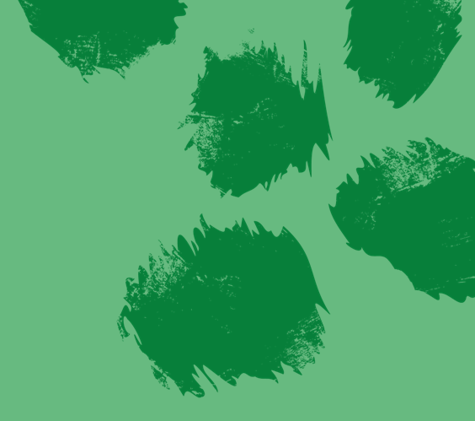


INSTRUCTIONS FOR TEACHERS:
Thank you for downloading the Hoverfly Heroes schools pack from the Royal Zoological Society of Scotland (RZSS) .
Key words are highlighted in bold/capitals throughout; a glossary can be found at the end of this document.
The speaker notes below each slide contain useful background information and ideas for class discussion.
Why not save this document as a PDF or share the activity pages with students to try at home?
We hope you enjoy the pack and thank you for your interest in RZSS native biodiversity conservation programmes!

Slide 2
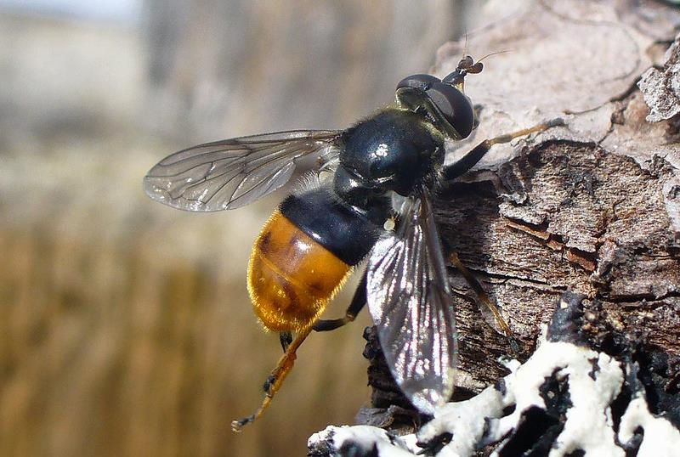

Hoverfly heroes!
Forestry and Land Scotland
The Pine Hoverfly (Blera fallax)

Slide 3
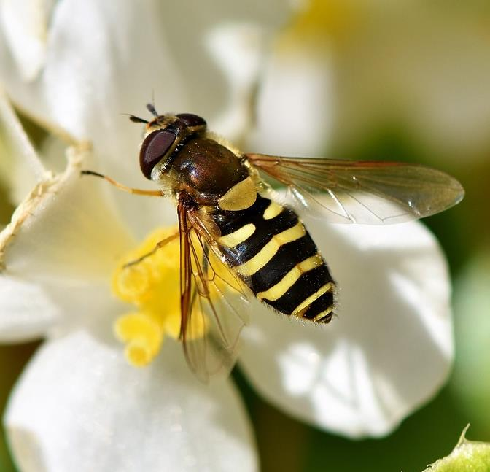






WHAT IS A HOVERFLY?
There are over 270 species of hoverfly in the UK!
LARGE EYES that cover most of their head
Many have yellow & black stripes to MIMIC wasps for defence!
Hoverflies have much shorter antennae than wasps
They have NO STING and are completely HARMLESS
Hoverflies visit flowers to drink nectar. They are important POLLINATORS.

Slide 4


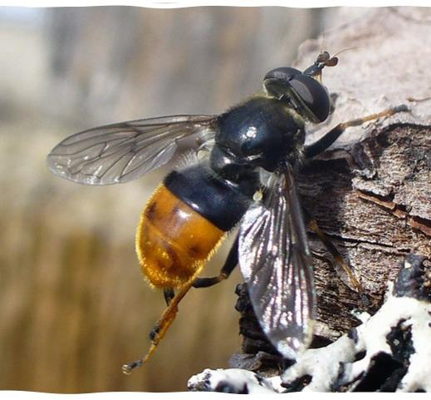
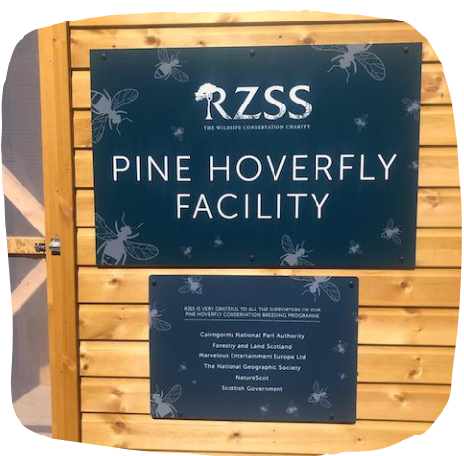
THE PINE HOVERFLY
MEET ONE OF The UK’s RAREST SPECIES!
RZSS has released 12,000 adults and larvae into the wild! They were bred at Highland Wildlife Park.
Notes:
Here at Highland Wildlife Park, we have a very special hoverfly called a pine hoverfly. They are important for the ecosystem as pollinators and waste recyclers, but they are very rare. Strathspey is now the only place we find them in the whole country! We breed pine hoverflies at the wildlife park and have now released 12,000 into the wild!

Slide 5







a year in the life of a pine hoverfly
Late summer - Eggs laid in rot hole
Larvae emerge a few weeks later
Early summer - They emerge as adults to mate & the cycle repeats
Larvae spend winter in the hole, freezing & thawing with the weather!
Next spring the larvae pupate
Flaticon

Slide 6

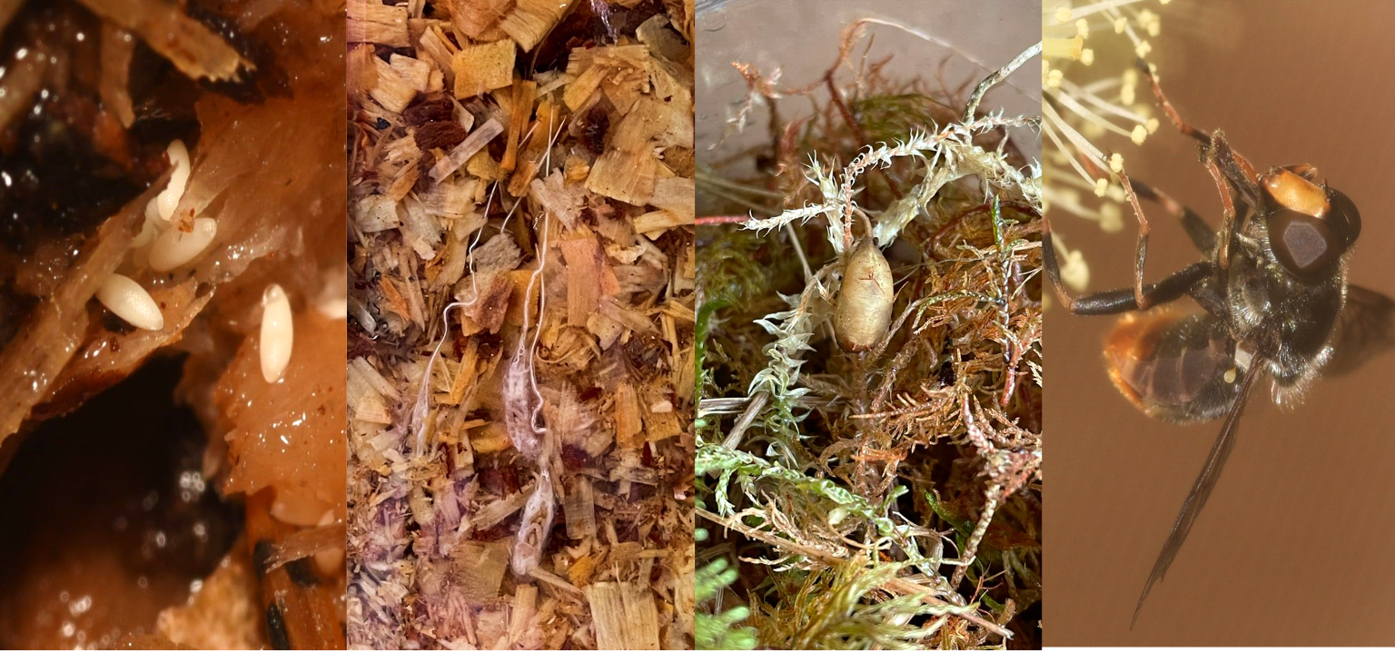
LIFE CYCLE OF A PINE HOVERFLY
Egg
Larva
Pupa
Adult
Notes:
Hoverflies have a lifecycle just like a butterfly. They start off as eggs, hatch into young forms called larvae (similar to a caterpillar but also known as a maggot). They then go into a pupa to transform into the adult hoverfly! When they are larvae, they have what looks like a long tail – it is actually a breathing tube that works a bit like a snorkel so they can breathe underwater!

Slide 7
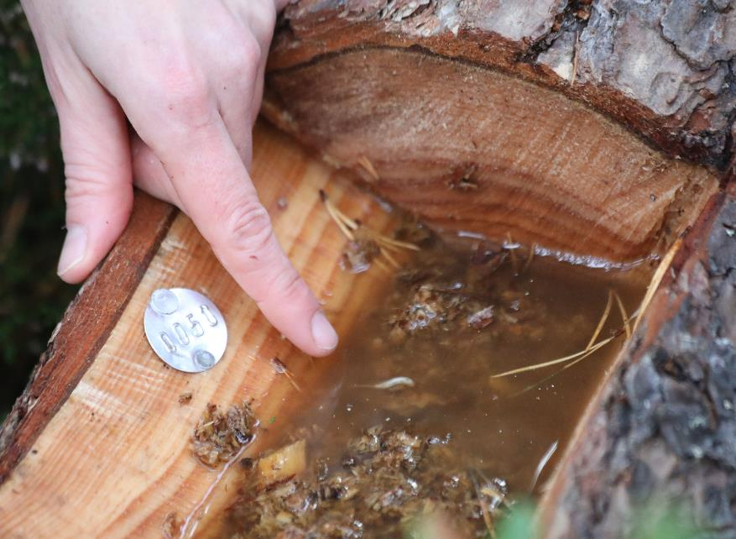





When the LARVAE are bigger, they crawl out of the stump and onto the surrounding moss or plants to PUPATE!
a wild home for Hoverflies
Eggs are laid in holes in pine trees.
The hole fills with rainwater and BACTERIA grow for the larvae to eat!
Notes:
Many hoverflies live underwater during the larval phase, including the pine hoverfly. In the wild, they would use rotten holes in trees filled with rainwater. Bacteria grow in these for them to eat.
Now days, natural rot holes can be few and far between, so we help pine hoverflies by creating artificial holes in tree stumps for them to use.

Slide 8
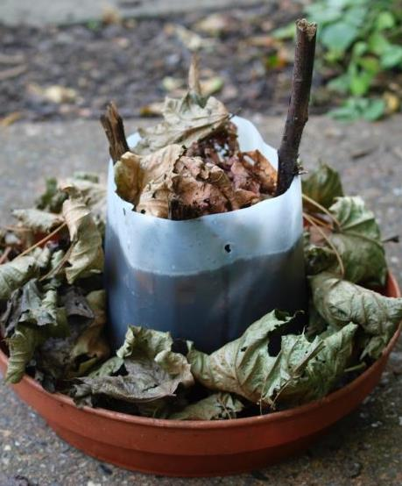

Hoverfly LAGOONS
Buzz Club
1
Find a plastic container 14-20cm deep.
Pierce an overflow hole roughly 1 inch from the brim on each side.
Fill the lagoon with grass, leaf litter or woodchips up to the line of the holes.
Add 2-3 sticks that reach all the way from the bottom to the top of the lagoon.
Fill with tap water to just below the holes.
Top with an inch of leaf litter up to the brim (this provides a landing platform for female hoverflies to lay their eggs).
Stand your lagoon in a tray filled with an inch of soil and an inch of leaf litter – this is where the larvae will pupate!
2
3
4
5
6
7
Make sure your pupation tray has holes, so it doesn’t flood with rainwater!
Notes:
You can help all sorts of local hoverflies at home by making your very own hoverfly lagoon!

Slide 9
GLOSSARY FOR TEACHERS
Key words are highlighted in bold/capitals throughout, please find definitions below:
POLLINATOR – an insect that carries pollen between plants so the plant can reproduce. ANTENNAE – ‘feelers’ on an insect’s head that let it detect the world around it.
LARVA – a young insect that looks worm-like & has no wings e.g. caterpillar, grub.
PUPA – stage when an insect is immobile and enclosed in a case, before transforming into an adult.​
METAMORPHOSIS–transformation process of life stages that most insects go through.
bacteria – tiny living things made up of a single cell. They live all around us but are so small that we need a microscope to see them!
BLERA FALLAX – The scientific name for the Pine Hoverfly.

