Slide 1
www.keepscotlandbeautiful.org
Name of presenter
Notes:
Introduction
Why are we talking about roadside litter?
Our planet is beautiful and we don’t want to pollute it / make it dirty
Scotland as one of most beautiful parts of the world (Rough Guides voted it most beautiful country in the world in Sept ’17) - https://www.roughguides.com/gallery/most-beautiful-country-in-the-world/
Blue Planet – who’s watched it? Litter that is ending up in our seas can come from our roadsides. 80% of marine litter comes from land based sources
Litter can be a threat to wildlife
Link to single use items in the news (cups, bottles etc)
It’s difficult to clean up and costs a lot to do so
Dangerous on the roads – and to those that have to clean it up

Slide 2
What is roadside litter?
Notes:
What do you see in this picture?
Roadside Litter
Litter that is thrown or dropped out of a car window
Litter that doesn’t make it to a bin and ends up on our roads – in our cities and in the countryside
What counts as roadside litter?
We have picked a few of the most regular offenders and will talk about them today

Slide 3
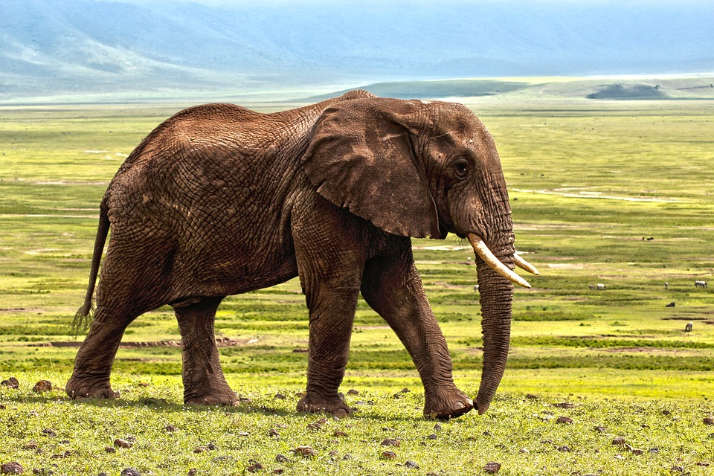
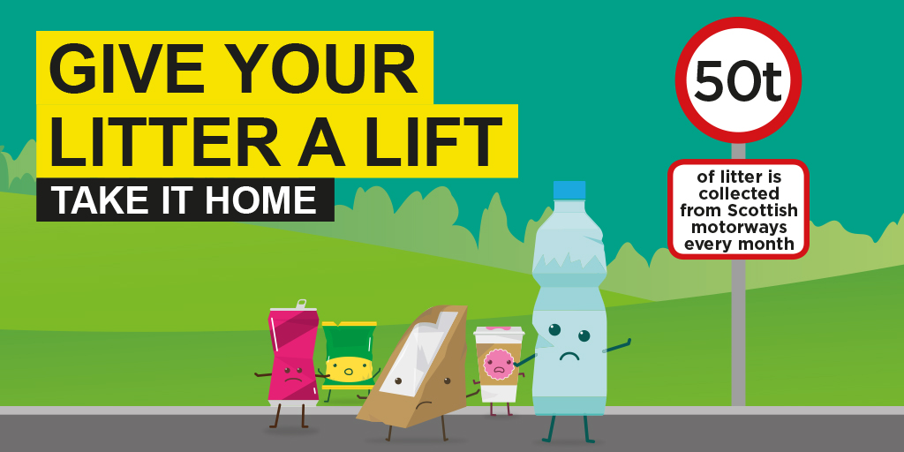
Fast Facts
That is the same weight as 8 African elephants
Notes:
We see a lot of litter at the side of our roadsides
88% of adults think roadside litter creates a negative impression of Scotland.
Every month, 50 tonnes is collected from Scottish motorways – this is the same weight as eight elephants
Pic - https://pixabay.com/en/elephant-safari-animal-defence-1421167/

Slide 4
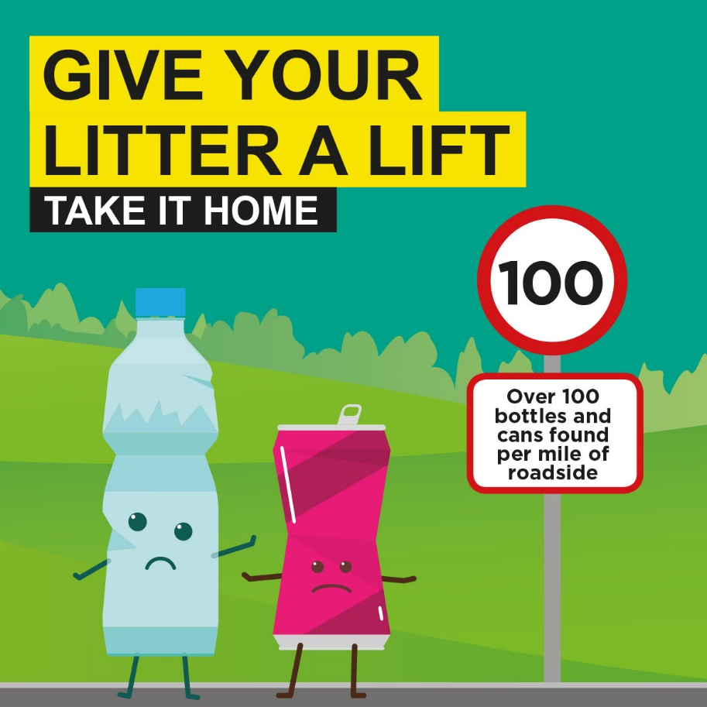
Litter types
We’re Fizz and Barry the Big Bottle.
We’re sad because over 100 of us are left behind on each mile of roadside
Notes:
Fizz & Barry - single use cold drinks items (bottle & can)
Introduce characters – important as over 100 bottles and cans are found for each mile of roadside in Scotland – i.e. they are very commonly discarded

Slide 5
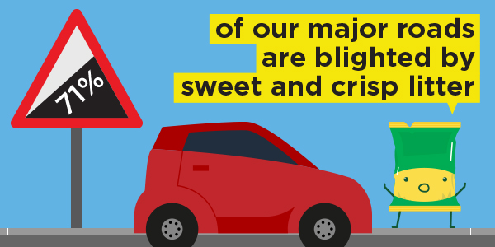
We’re Wido and Coco and we’re left behind on 71% of major roads
Notes:
Wido & Coco
Crisp and sweet wrappers are found by the side of 71% of Scotland’s roads

Slide 6
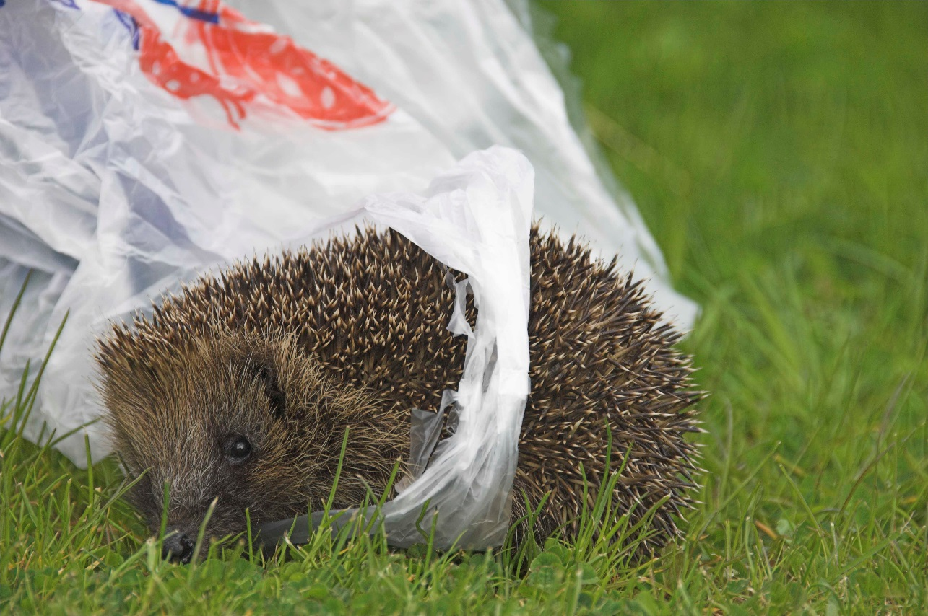
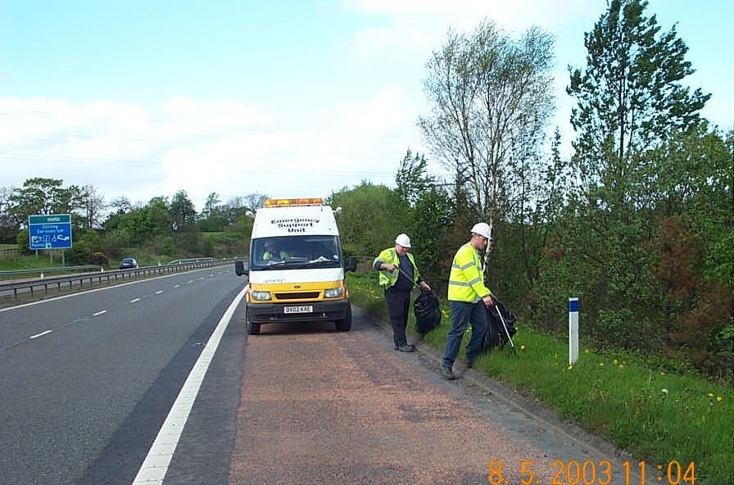
Why is roadside litter a problem?
Notes:
Why is it a problem
Danger to wildlife
Litter can be a danger to animals that live by the side of the road.
They can get caught up in the litter or can try and use it for shelter
Danger to those who clean it up
Traffic moves very fast on motorways, and the people that have to clean up roadside litter are in danger when cars drive past at high speed
It is also dangerous for drivers, as it can get in the way of their windscreen/view of the road
Expensive
It costs a lot of money & takes a lot of time to clean up roadside litter
Many hours spent on this, that could be spent on other things

Slide 7
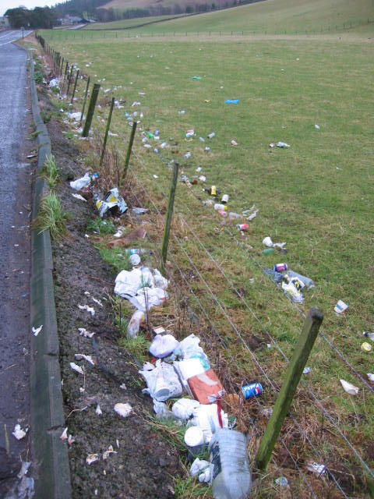
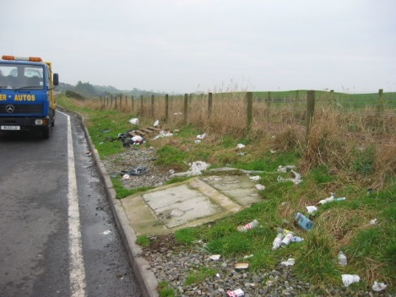
How many of our characters have you seen left behind in the past week?
Notes:
Tally activity
Which of the characters might you see in these photos?
How does it look?
How do you think this litter is picked up?
If you wanted to extend this task you could undertake a local litter pick and discuss your real data at this point? If you have conducted a litter pick…what did you find? Can you separate the litter in to different types?
Discuss appropriate disposal of items – e.g. bins, recycling, taking rubbish home for correct disposal if no bins,
Where can you dispose of these items in your school or local community?

Slide 8
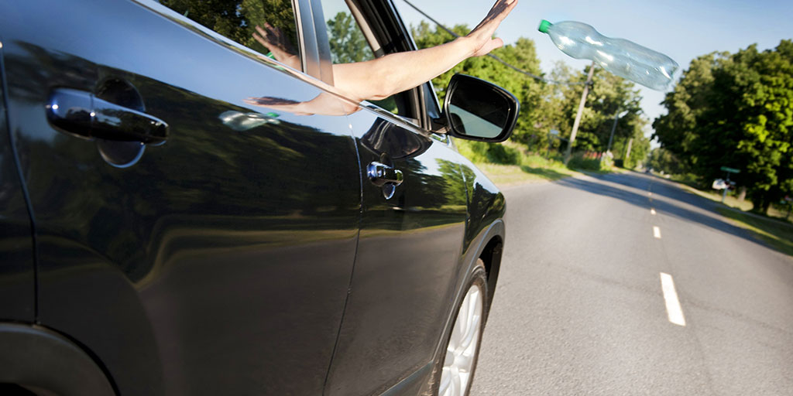
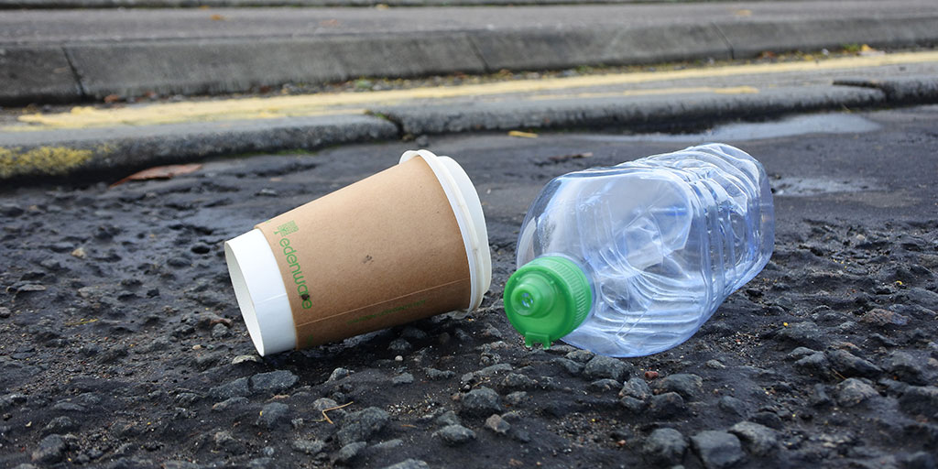
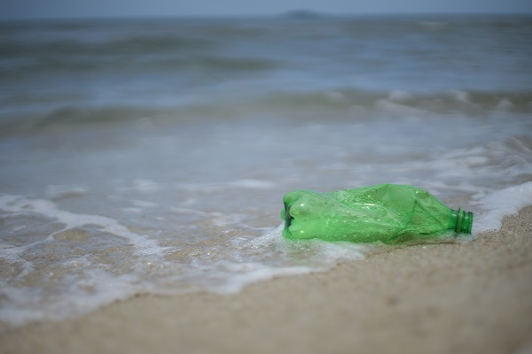
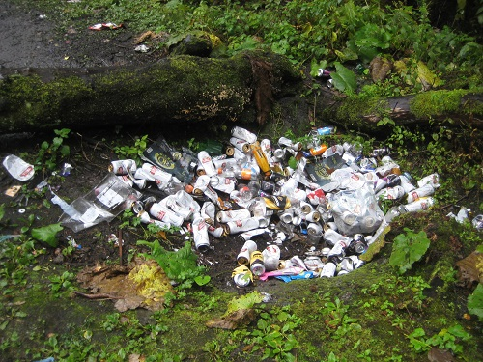
Where can roadside litter end up?
Notes:
We’ve already talked about how 80% of litter in our canals, rivers and seas begins its journey from places inland.
Here is a potential journey that our litter can take when thrown from car windows.
Litter that is dropped on our roadsides can end up in our oceans – dangerous for wildlife/animals that live here as well as for animals on land.
Q) In the school grounds, where can you put your litter when you’re finished with it?
Q) Outside of school, where might you put your rubbish when you’re finished with it?

Slide 9
How do you feel about roadside litter?
Notes:
If you could speak on behalf of one of these fellows, why do you think people should give them a lift…?
Ie. “Give me a lift because… I’m sad and lonely by the roadside. Please put me in a bin”.

Slide 10
Notes:
Pupils can submit one entry each
• The competition is open to pupils from Nursery to Primary 7 in Scotland
• Submissions can be written or drawn by hand or created on the computer
• The submission should fit within the speech bubble on the A4 template
• Entries will be considered on: o their ability to simply communicate a message in a creative manner
o their visual appeal (bright and colourful)
• By submitting an entry to the Caption Competition, you are giving us permission to use it for marketing and communications purposes
Timescales
• Deadline for competition entries – Friday 4th May 5pm
• Shortlisted entries for each category notified – Thursday 10th May
• Online voting for category winners – Monday 12th to Sunday 20th May
Competition Categories
• Nursery – P3
• P4 - P7
Entries should be sent to:
Keep Scotland Beautiful,
Glendevon House,
The Castle Business Park,
Stirling, FK9 4TZ
Or emailed to takeithome@keepscotlandbeautiful.org

