Slide 1
Keills Pocket Garden
Islay Life

Slide 2
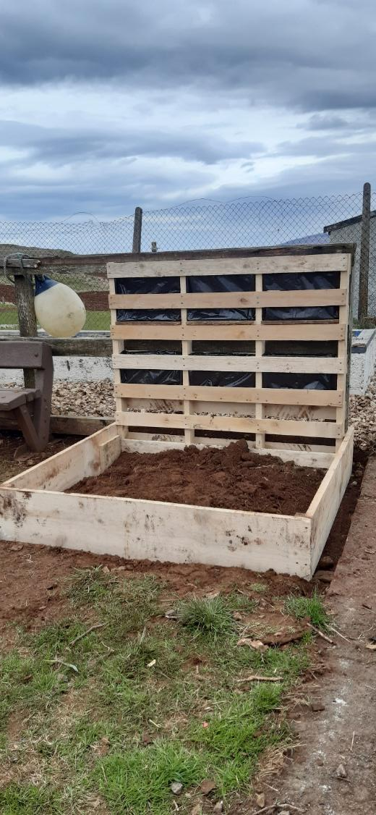
1. Basic frame

Slide 3
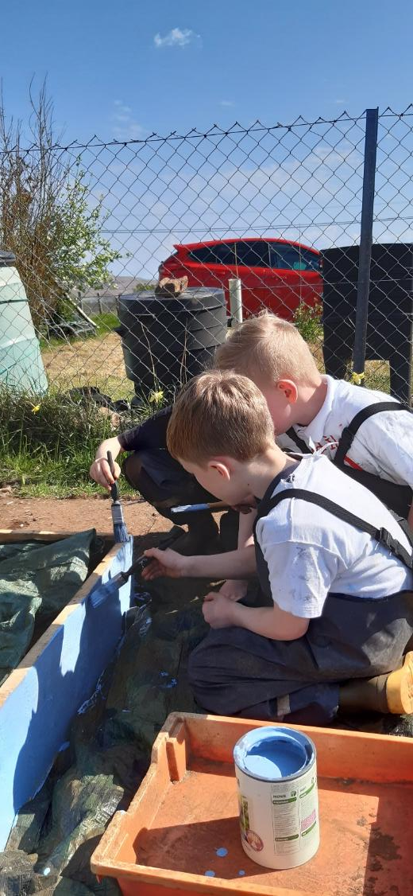
2. Painting

Slide 4
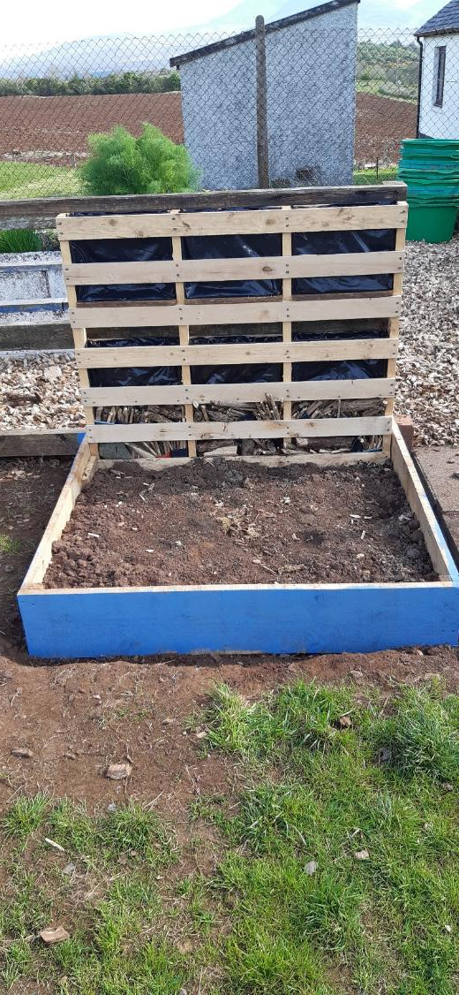
3. Pocket garden painted

Slide 5
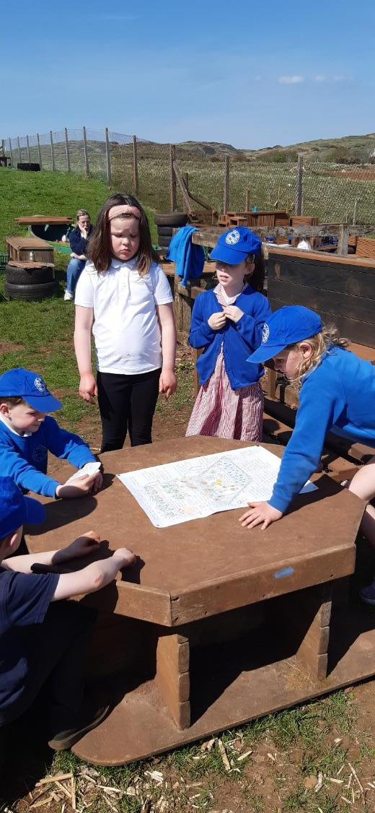
4. Looking at pocket plans

Slide 6
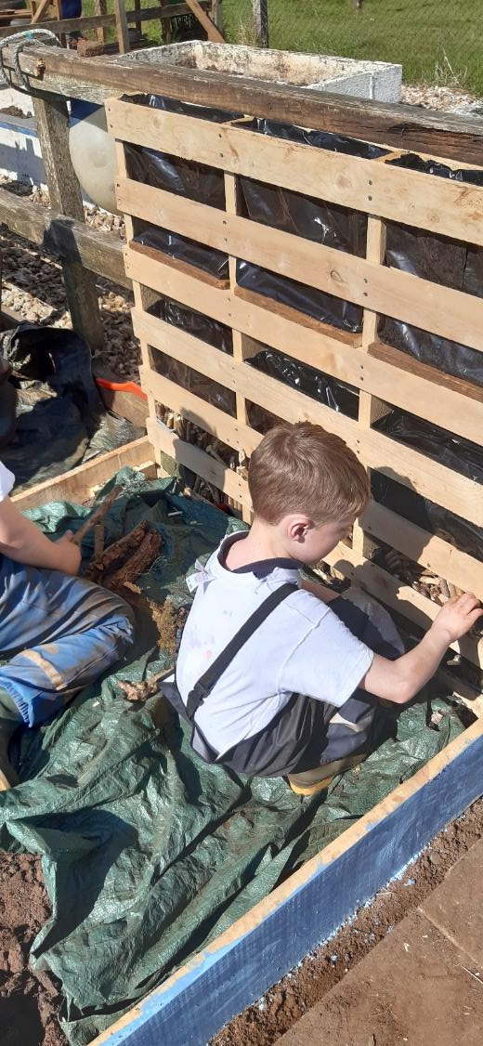
5. Making minibeast hotel 1

Slide 7
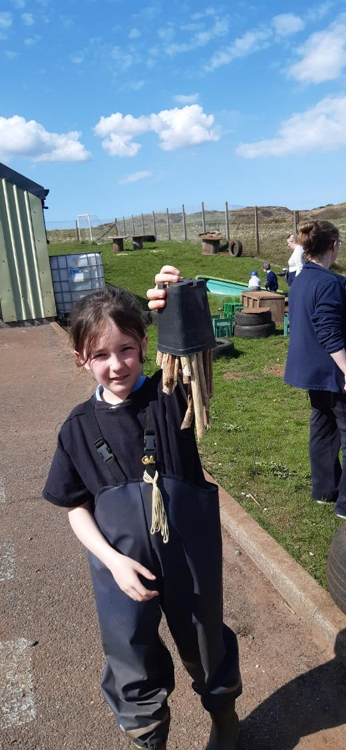
6. Making minibeast hotel 2

Slide 8
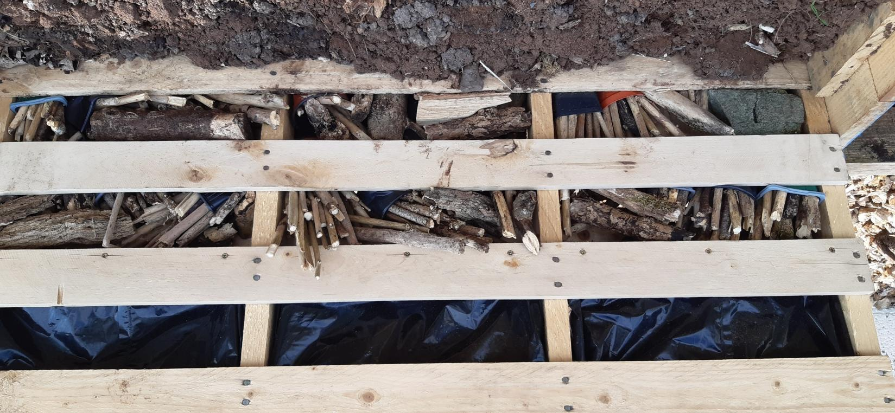
7.Minibeast hotel made

Slide 9
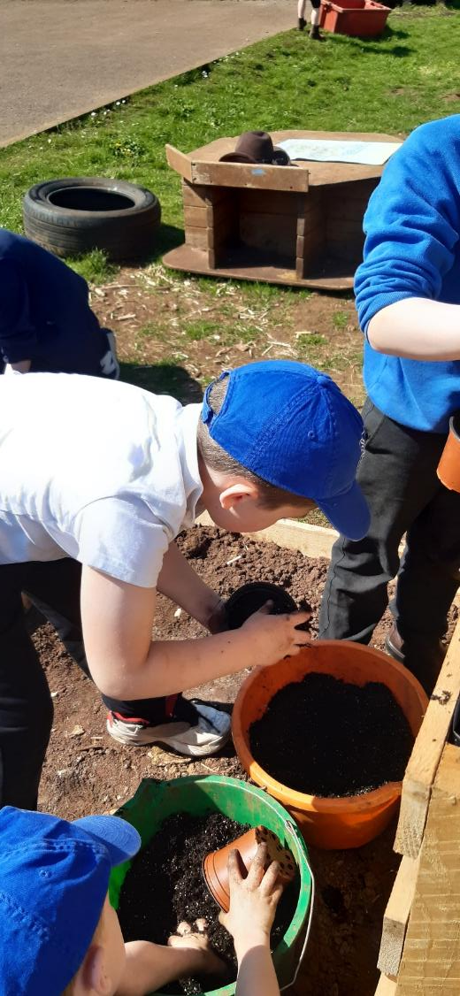
8. Prep for strawberries 1

Slide 10
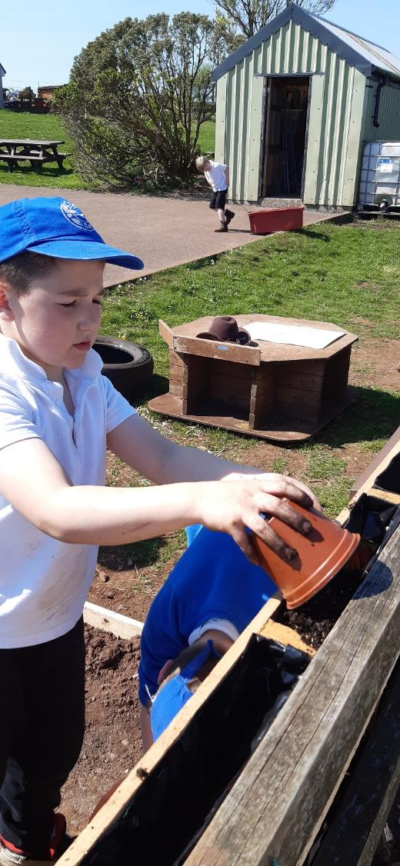
9. Prep for strawberries 2

Slide 11
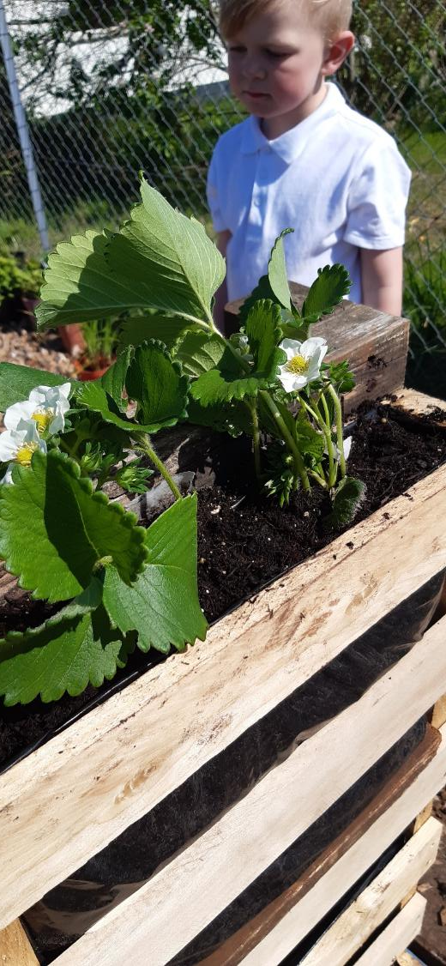
10. Strawberries in

Slide 12
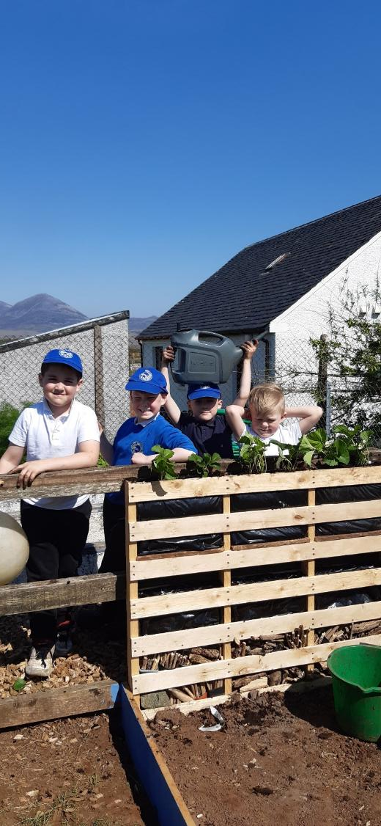
11. Strawberry planting team

Slide 13
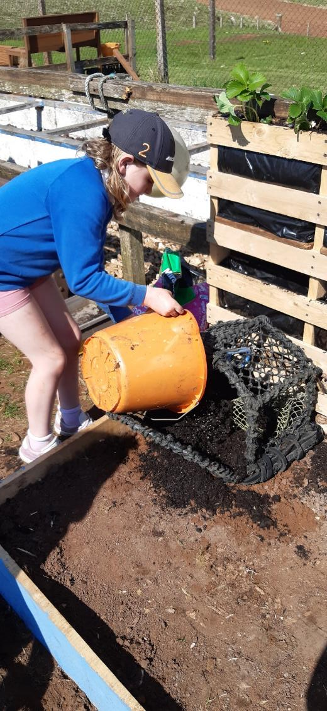
12. Creel 1

Slide 14
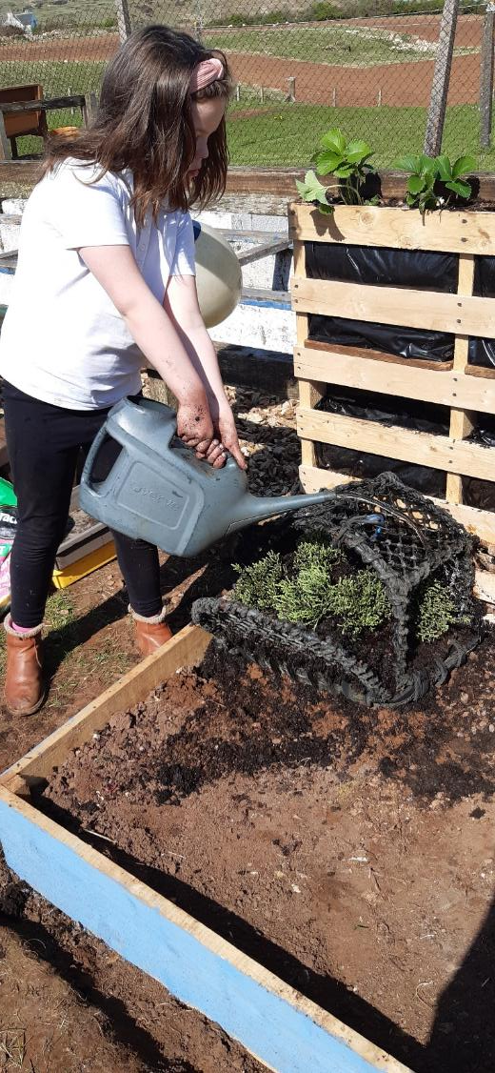
13. Creel 2

Slide 15
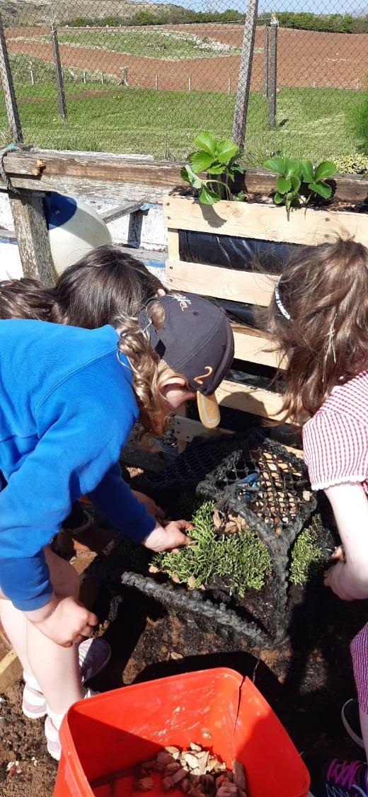
14. Creel 3

Slide 16
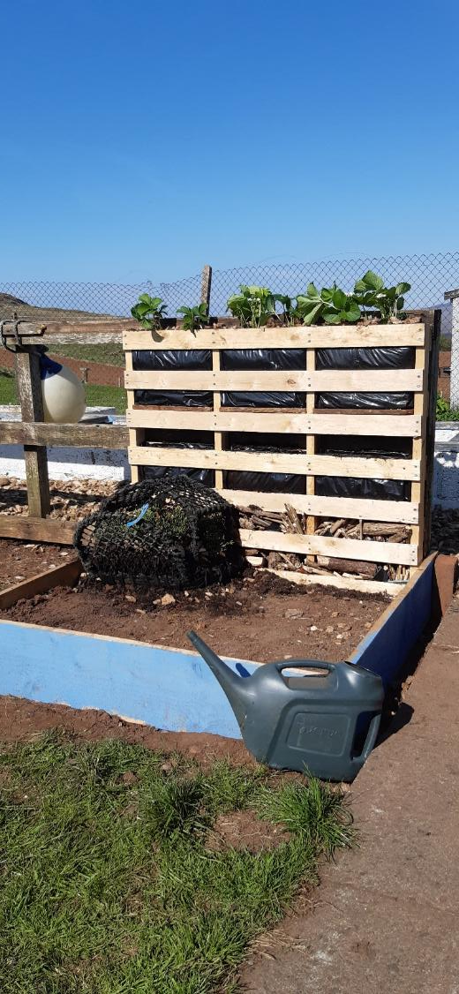
15. Strawberries and creel

Slide 17
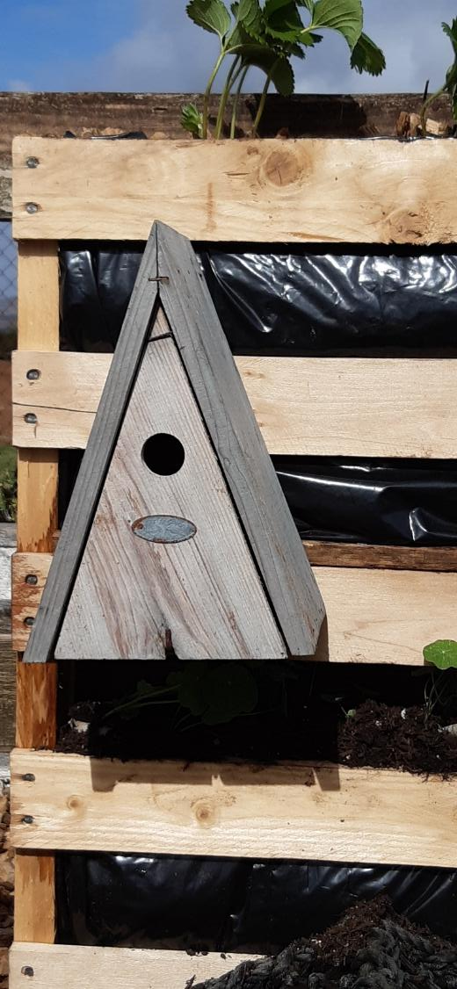
16. Bird house

Slide 18
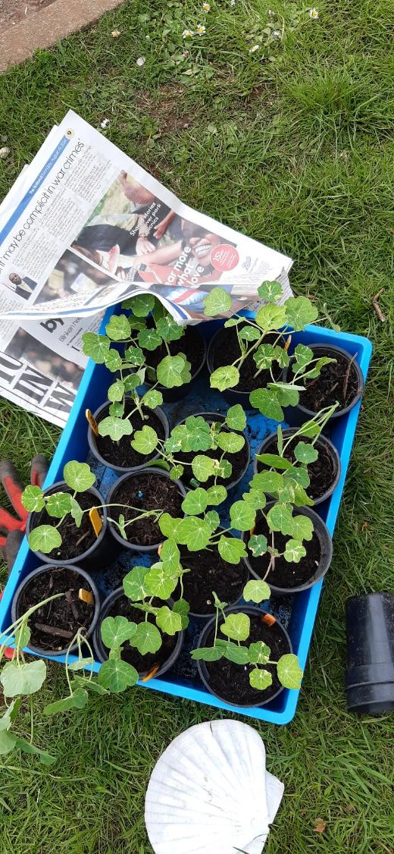
17. Nasturtiums

Slide 19
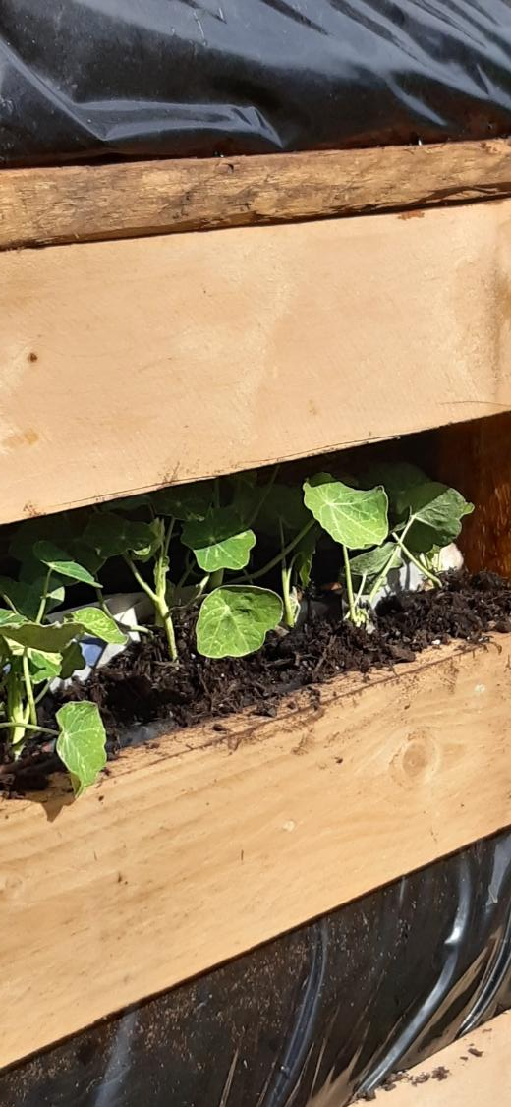
18. Nasturtiums planted

Slide 20
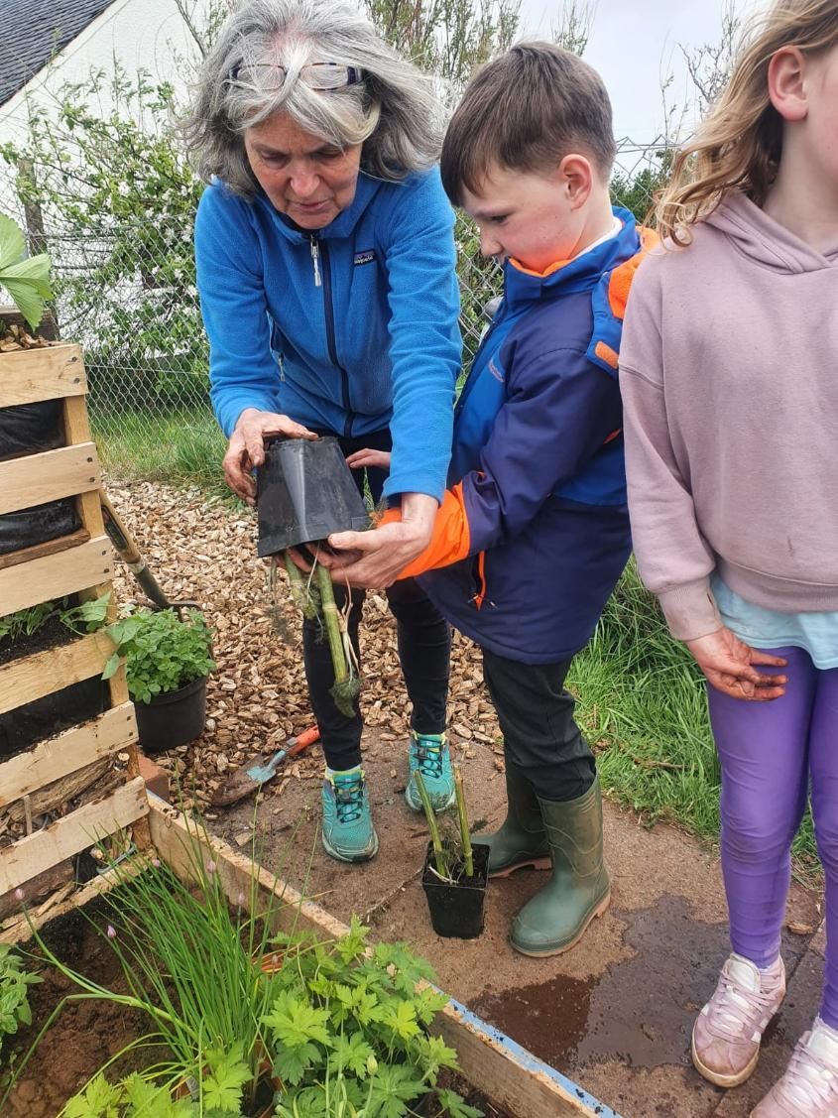
19. Perennials 4

Slide 21
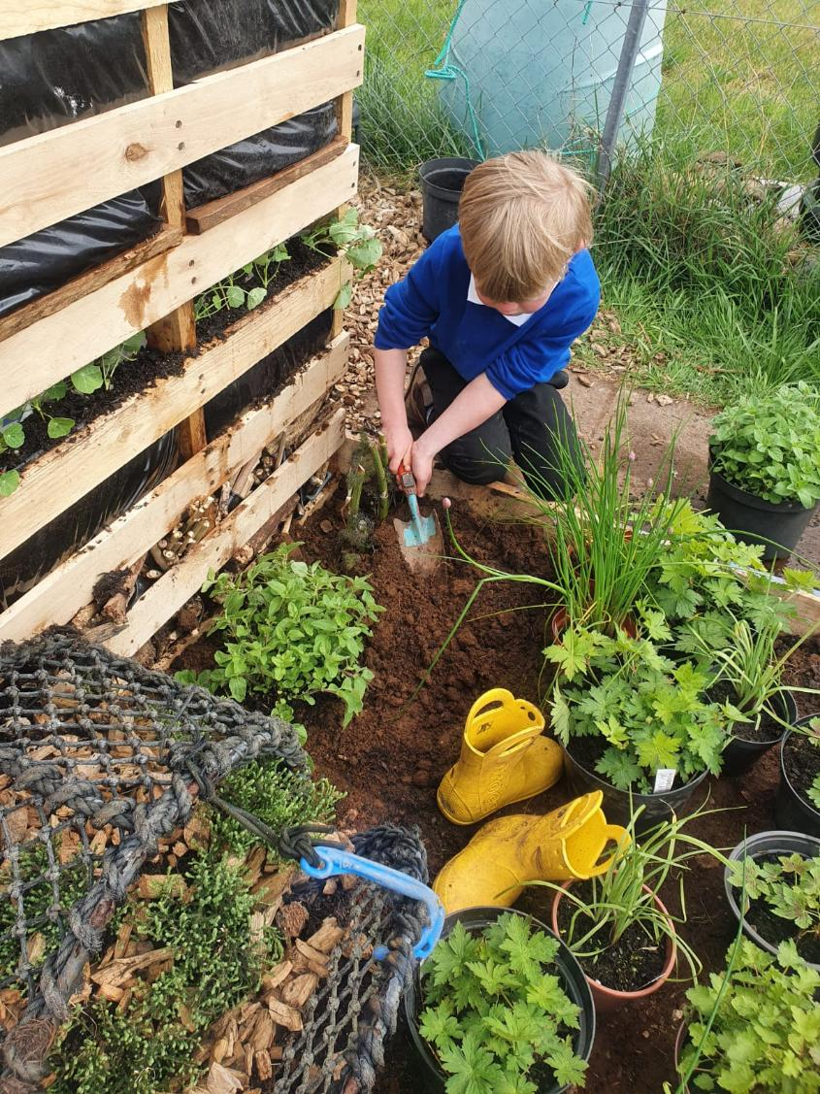
20. Perennials 5

Slide 22
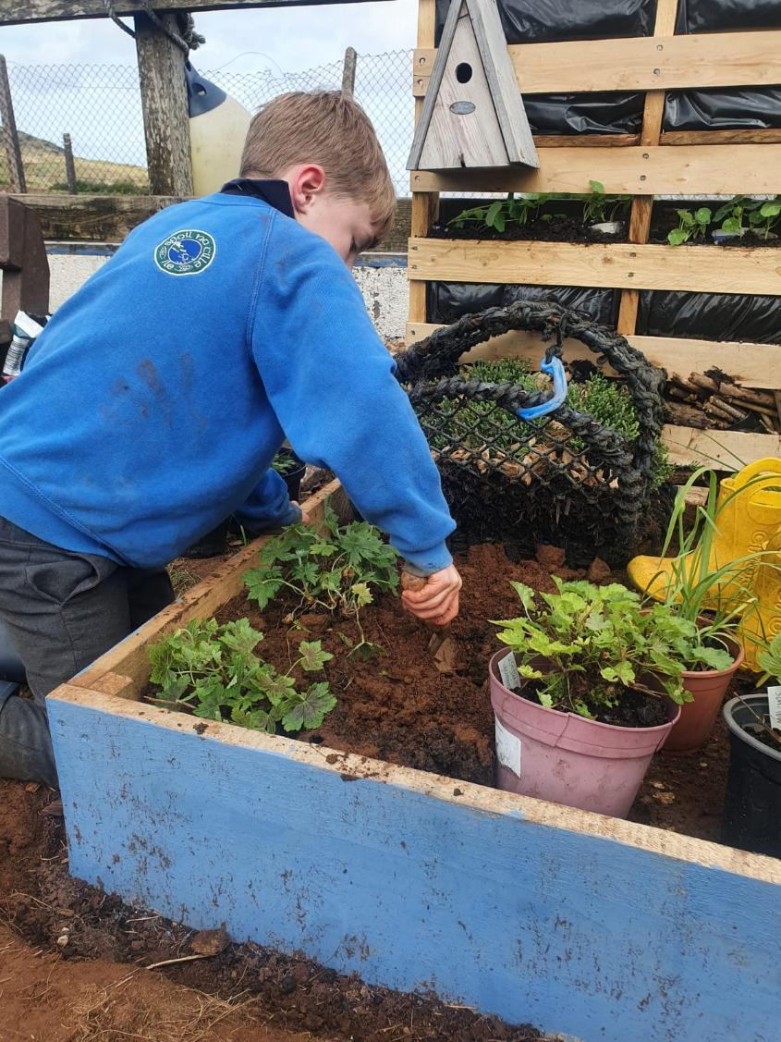
21. Perennials 6

Slide 23
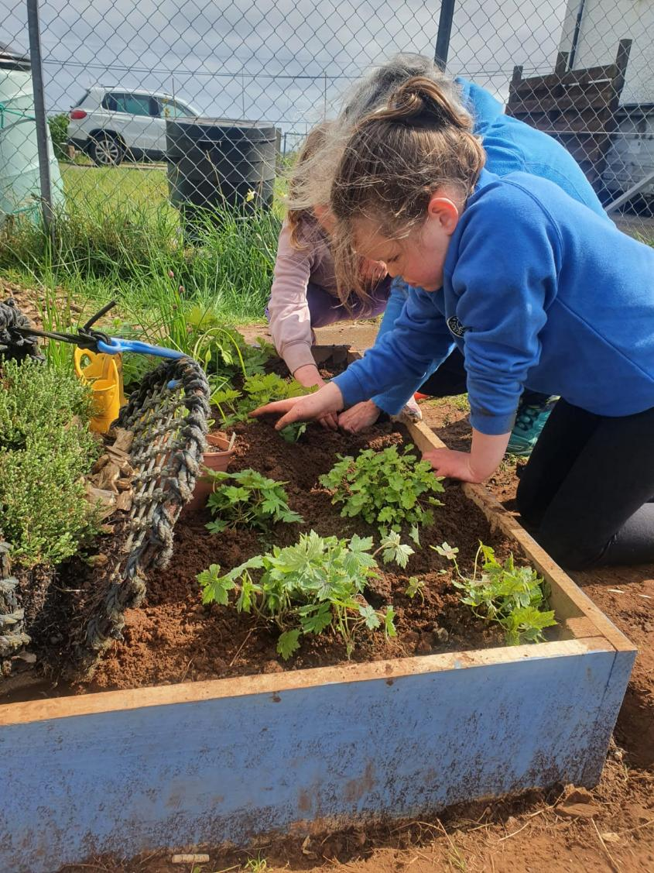
22. Perennials 7

Slide 24
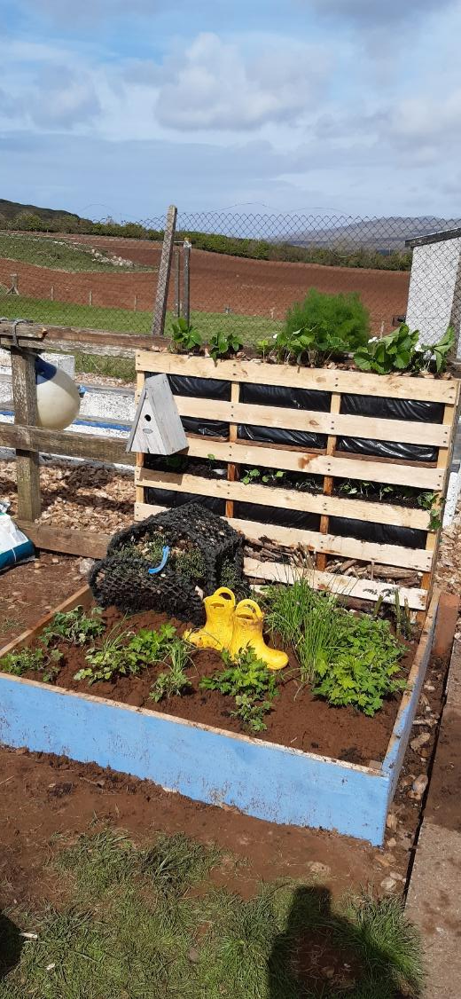
23. Pocket garden 1st May a

Slide 25
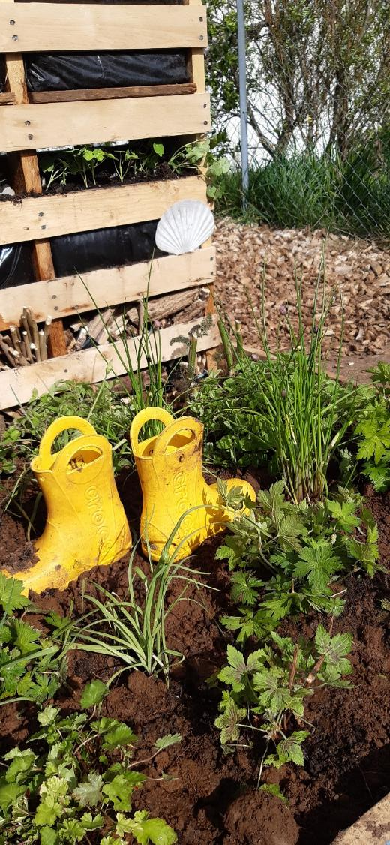
24. Pocket garden 1st May b

Slide 26
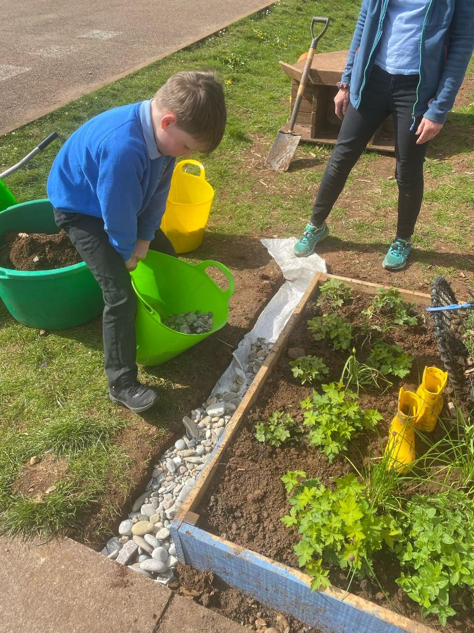
25. Pocket garden stones

Slide 27
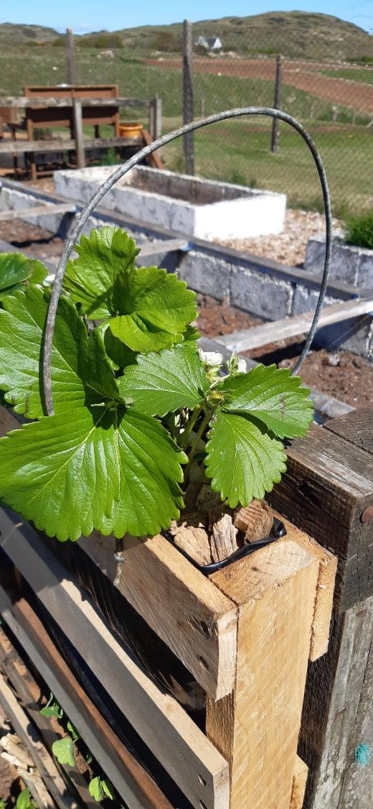
26. Strawberry protection 1

Slide 28
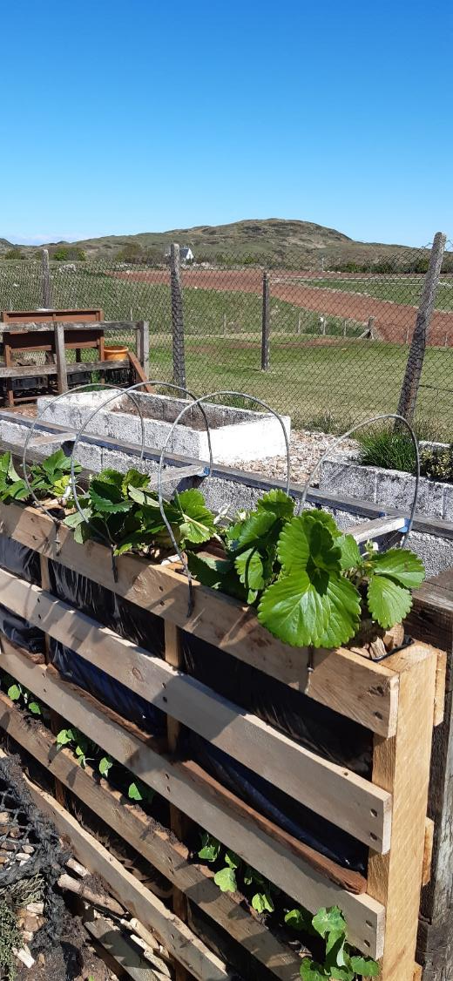
27. Strawberry protection 2

Slide 29
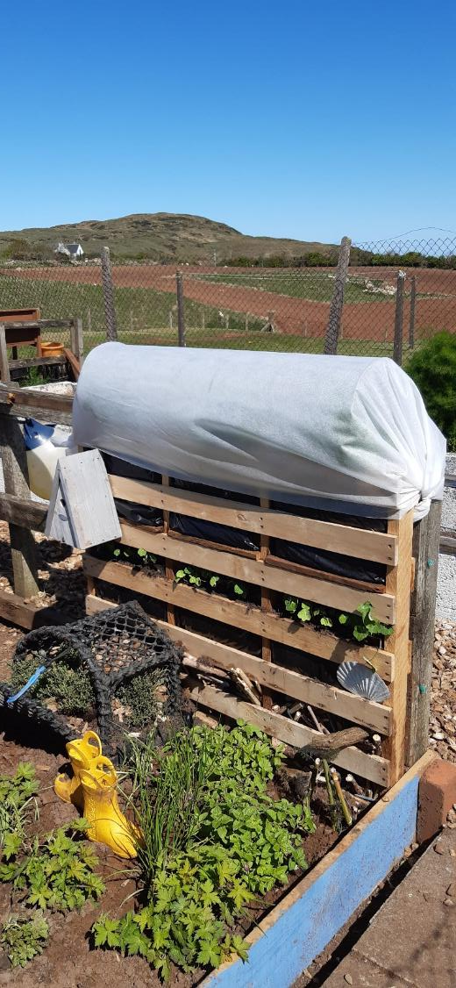
28. Strawberry polytunnel

Slide 30
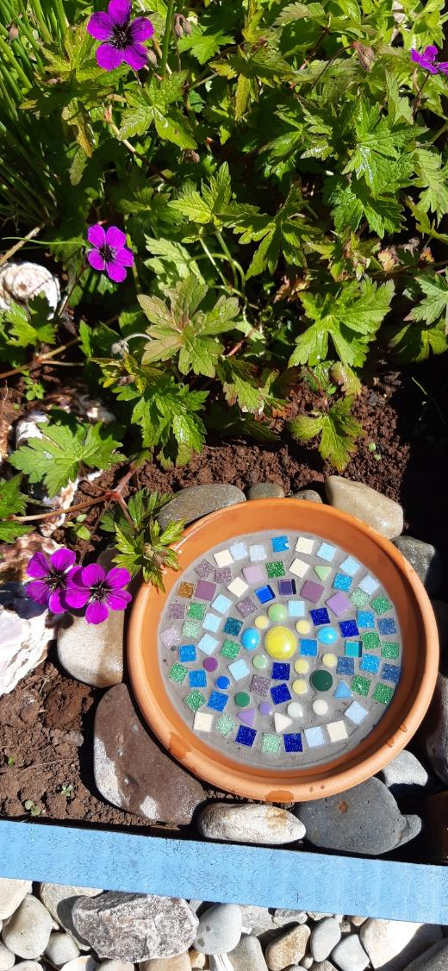
29. Bird bath

Slide 31
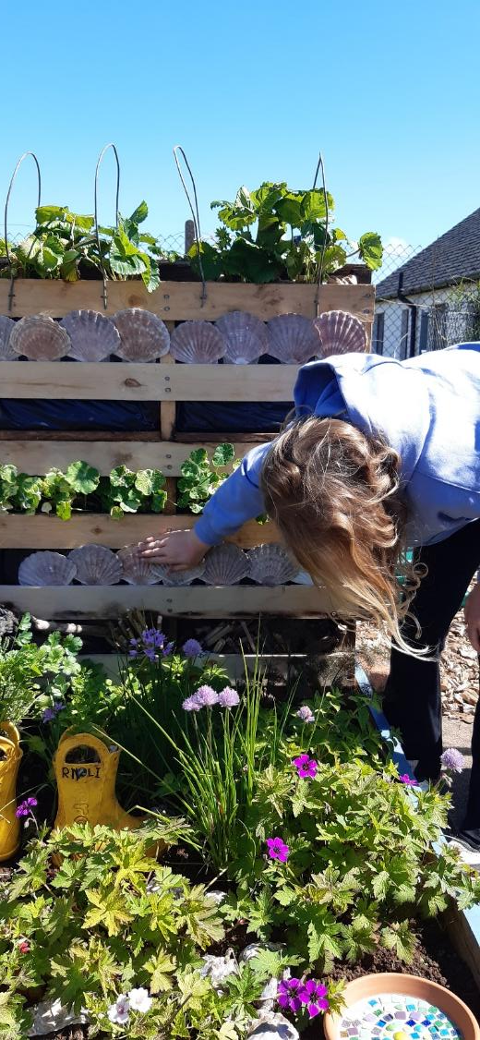
30. Scallop shells

Slide 32
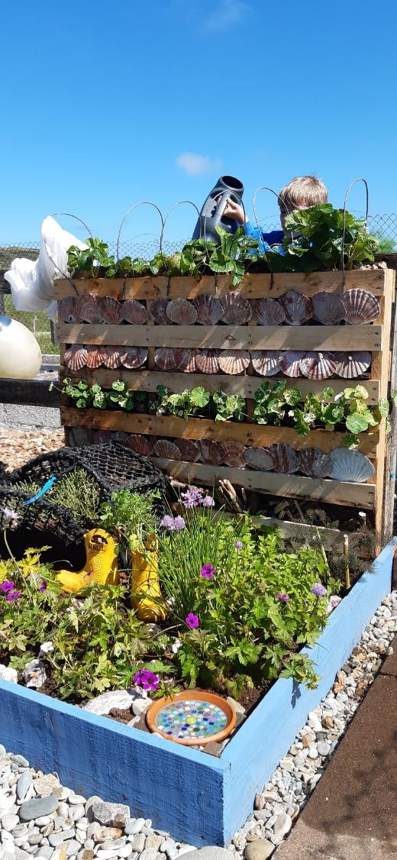
31. Watering 1

Slide 33
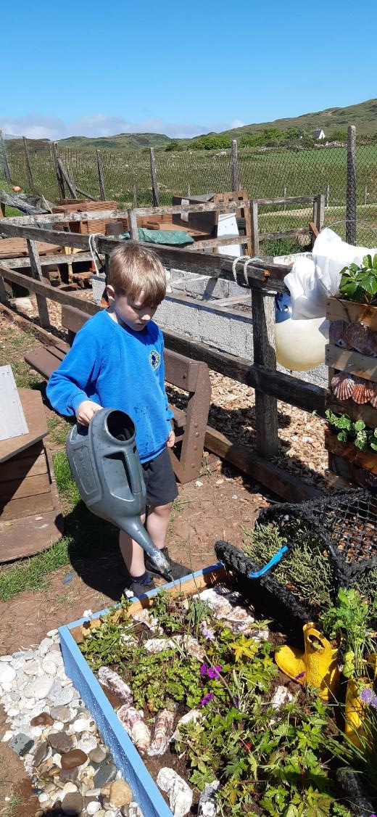
32. Watering 2

Slide 34
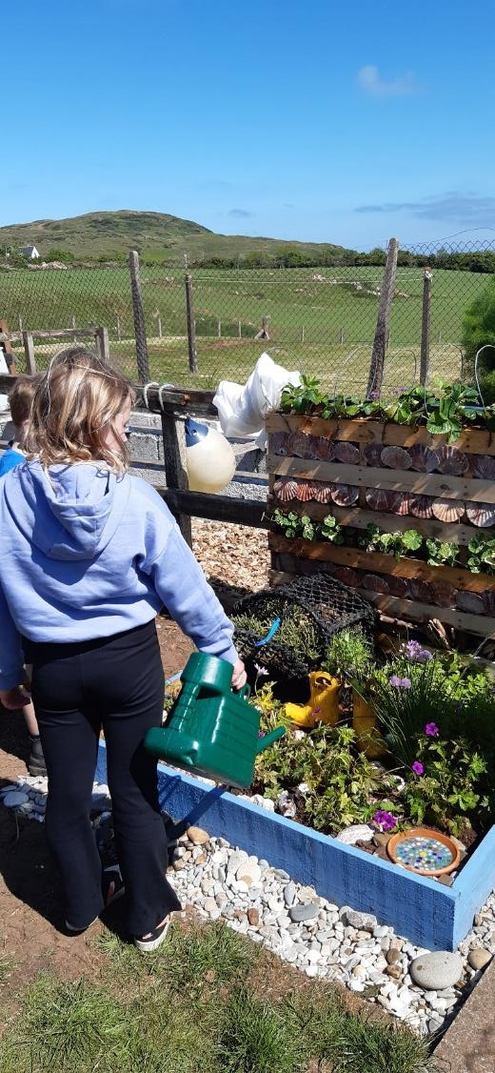
33. Watering 3

Slide 35
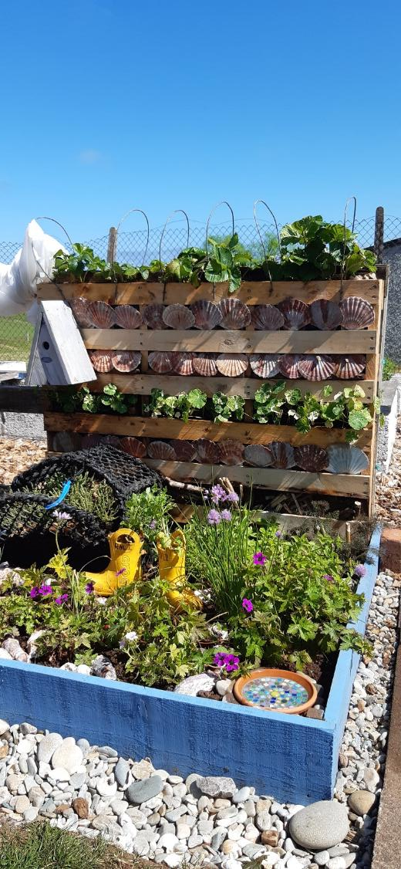
34. Garden 21st May

Slide 36
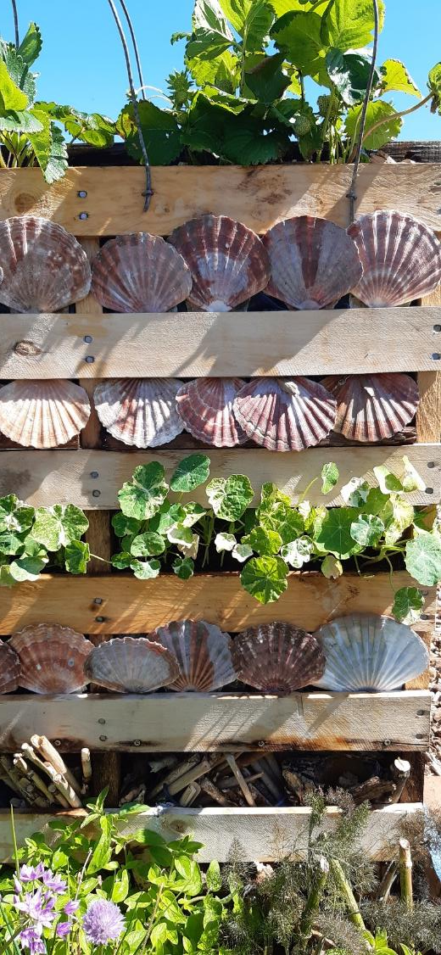
35. Back wall 21st May detail

Slide 37
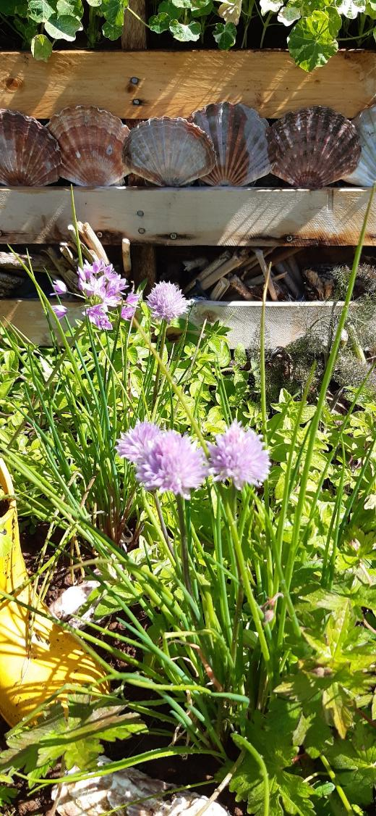
36. Chives and alliums

Slide 38
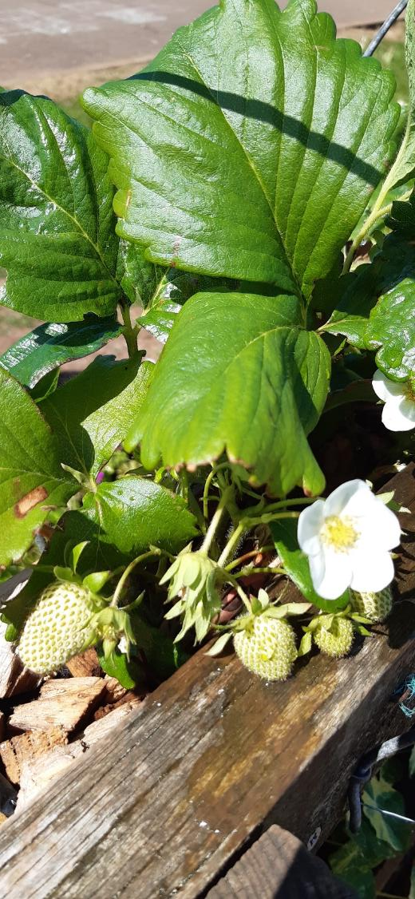
37. Green strawberries

Slide 39
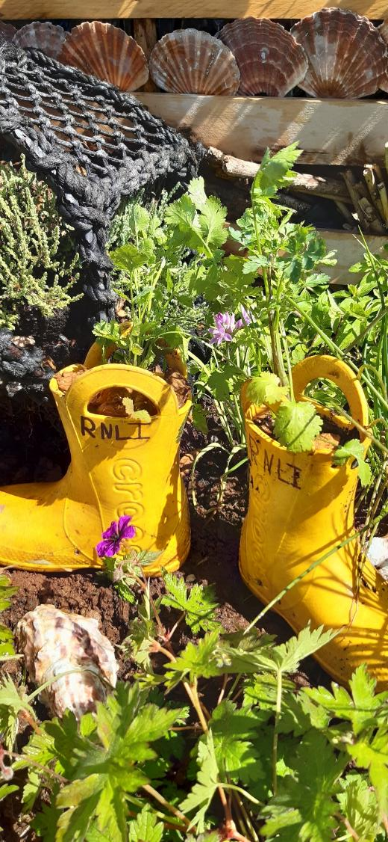
38. Wellies

