Slide 1
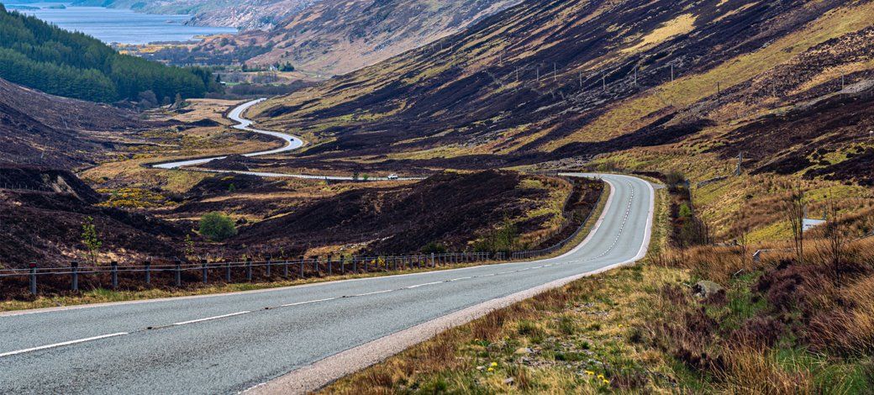
Roadside Litter
55%
of audited roadsides had a presence of litter
Roadside Litter
Notes:
Introduction
-Why are we talking about roadside litter?
-Our planet is beautiful and we don’t want to pollute it / make it dirty

Slide 2
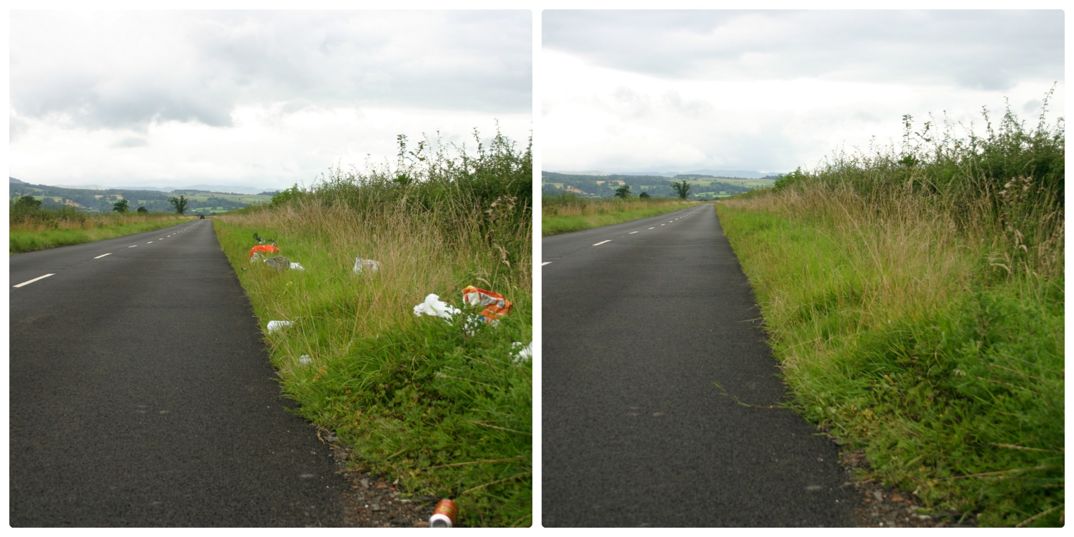
What is Roadside Litter
Notes:
What do you see in this picture?
Roadside Litter
-Litter that is thrown or dropped out of a car window
-Litter that doesn’t make it to a bin and ends up on our roads – in our cities and in the countryside
What counts as roadside litter?
We have picked a few of the most regular offenders and will talk about them today

Slide 3
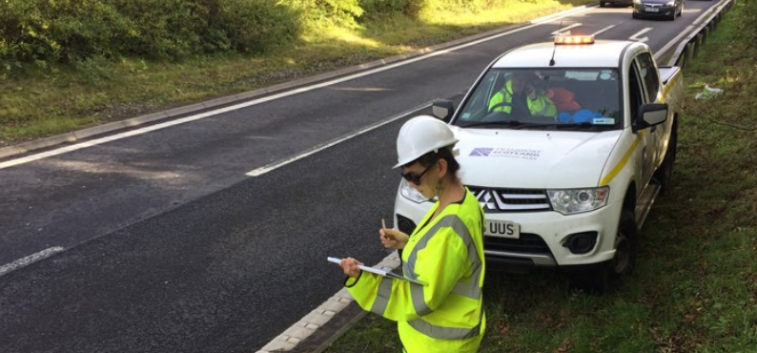
What the data shows us
55%
of audited road
sites had a presence of litter
91%
agree roadside litter creates a negative impression of Scotland
Notes:
What the data shows us
-Scotland is one of most beautiful parts of the world but 55% of audited roadsides had a presence of litter
-Roadside litter creates a negative impression of Scotland (91% agree)
-Litter can be a threat to wildlife
-It’s difficult to clean up and costs a lot to do so
-Dangerous on the roads – and to those that have to clean it up

Slide 4





44%
of littered items were food and drink related
Notes:
Link to single use items in the news (cups, bottles etc)
44% of littered items were food and drink related

Slide 5
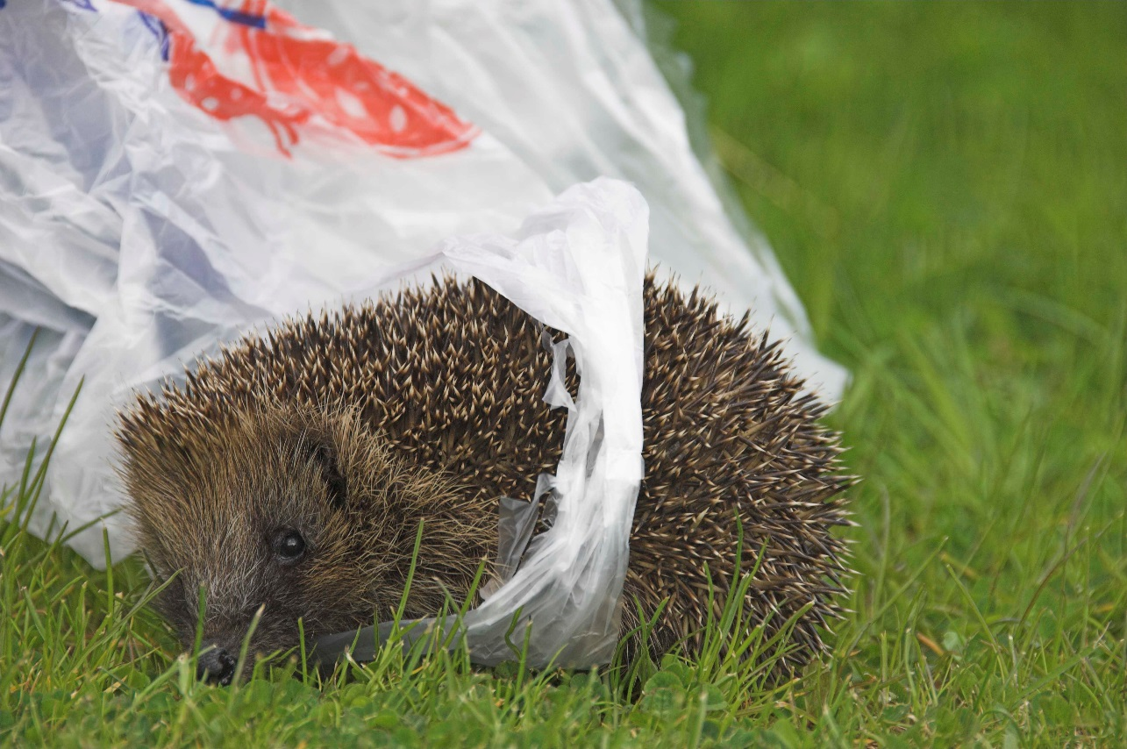
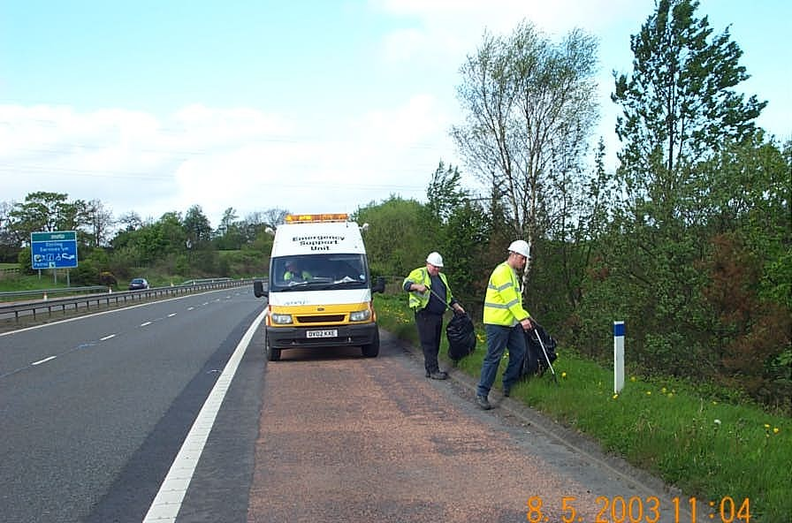
Why is roadside litter a problem?
Notes:
Why is it a problem
Danger to wildlife
Litter can be a danger to animals that live by the side of the road
They can get caught up in the litter or can try and use it for shelter
Danger to those who clean it up
Traffic moves very fast on motorways, and the people that have to clean up roadside litter are in danger when cars drive past at high speed
It is also dangerous for drivers, as it can get in the way of their windscreen/view of the road
Expensive
It costs a lot of money & takes a lot of time to clean up roadside litter
Many hours spent on this, that could be spent on other things

Slide 6

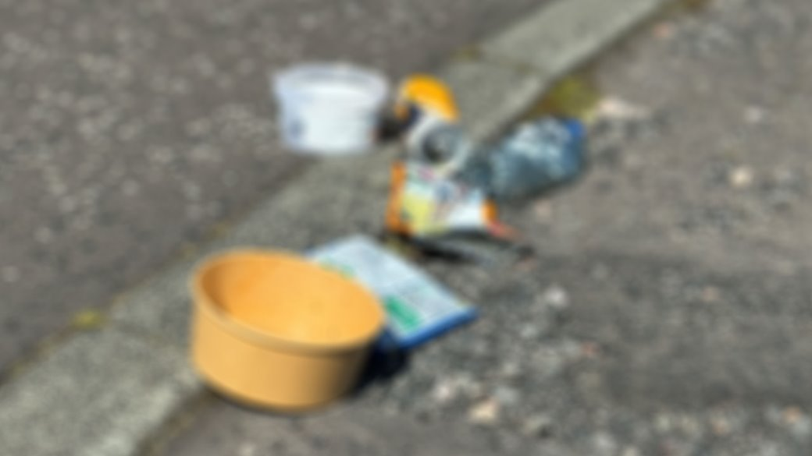

How many of our characters have you seen left behind in the past week?
Notes:
Spotting activity
Which of the characters might you see in this photos?
How does it look?
How do you think this litter is picked up?
If you wanted to extend this task you could undertake a local litter pick and discuss your real data at this point? If you have conducted a litter pick…what did you find? Can you separate the litter in to different types?
Discuss appropriate disposal of items – e.g. bins, recycling, taking rubbish home for correct disposal if no bins,
Where can you dispose of these items in your school or local community?

Slide 7


Notes:
80% of litter in our canals, rivers and seas begins its journey from places inland.

Slide 8
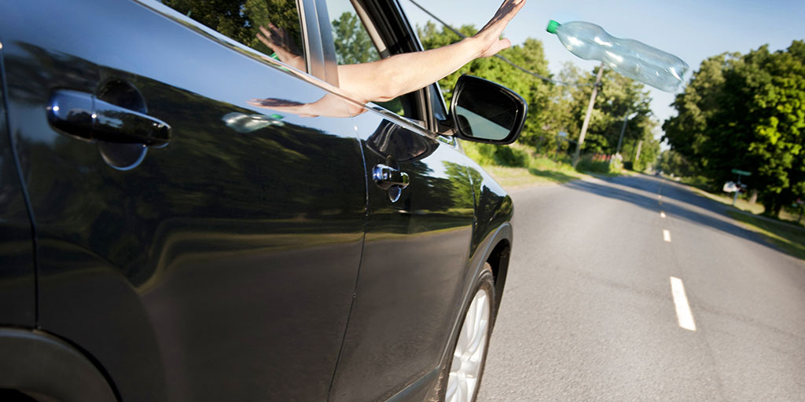
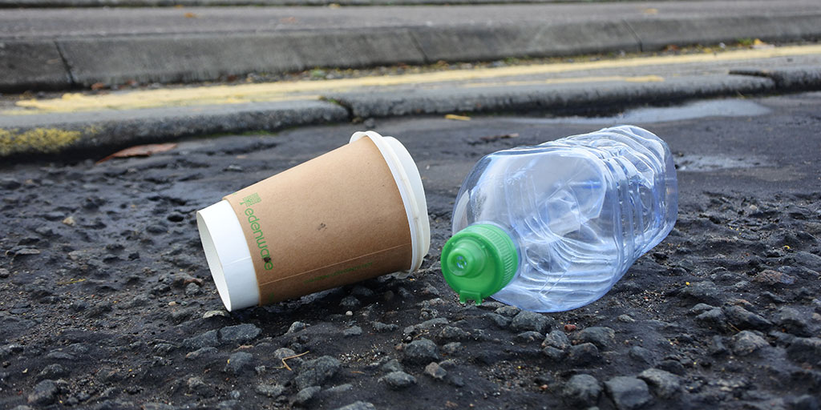
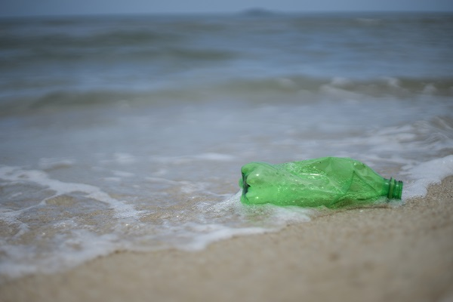
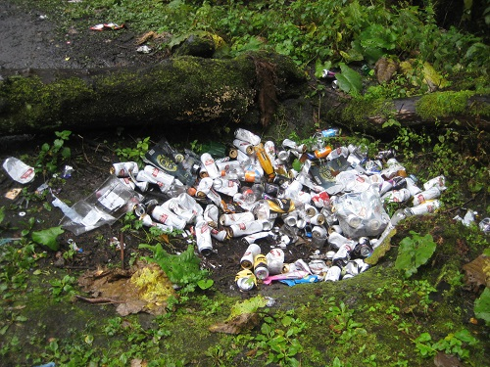
Where can roadside litter end up?
Notes:
Here is a potential journey that our litter can take when thrown from car windows.
Litter that is dropped on our roadsides is dangerous for wildlife/animals that live on land and in the ocean.
Q) In the school grounds, where can you put your litter when you’re finished with it?
Q) Outside of school, where might you put your rubbish when you’re finished with it?

Slide 9
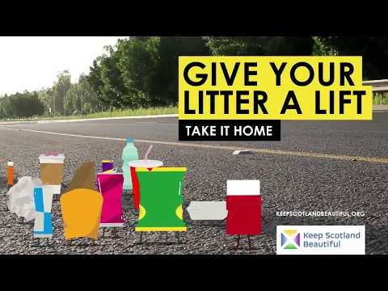
How do you feel about roadside litter?
Notes:
If you could speak on behalf of one of these fellows, why do you think people should give them a lift…?
Ie. “Give me a lift because… I’m sad and lonely by the roadside. Please put me in a bin”.

Slide 10
Caption Art
Competition
The competition is open to pupils from Nursery to Primary 7 in Scotland.
Entries will be considered on:
their ability to simply communicate a message in a creative manner
their visual appeal (bright and colourful)
One entry from each category will be chosen to be made into a roadside banner that can be deployed as part of our roadside litter campaign
Notes:
Guidelines and advice
The competition is open to pupils from Nursery to Primary 7 in Scotland
Pupils can submit one entry each
Submissions can be written or drawn by hand or created on the computer
The submission should fit within the speech bubble on the A4 template
Entries will be considered on:
their ability to simply communicate a message in a creative manner
their visual appeal (bright and colourful)
By submitting an entry to the Caption Art Competition, you are giving us permission to use it for marketing and communications purposes
Competition Categories:
• Nursery – P3
• P4 – P7
Timeframe:
• Deadline for competition entries – Friday 27th February 5pm
• Shortlisted entries for each category notified – Friday 7th March
• Category winners announced – Wednesday 11th March
Competition Categories
• Nursery – P3
• P4 – P7

Slide 11
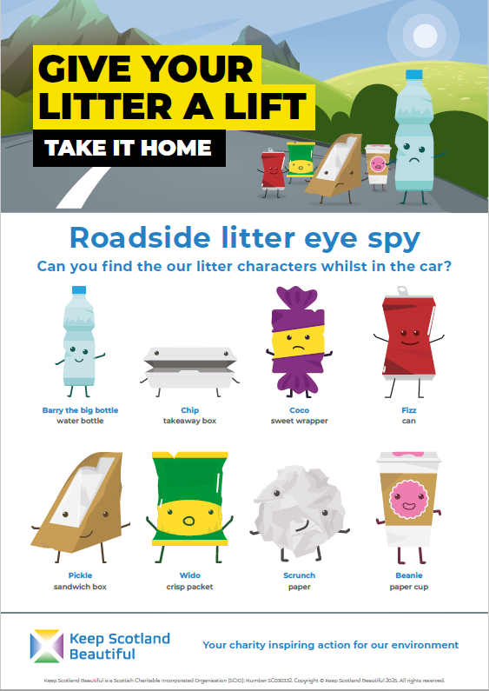
Roadside litter eye spy
A roadside litter Eye Spy sheet is available on our resources page. The next time you are in the car take one along and see how many characters you can spot!

