Slide 1
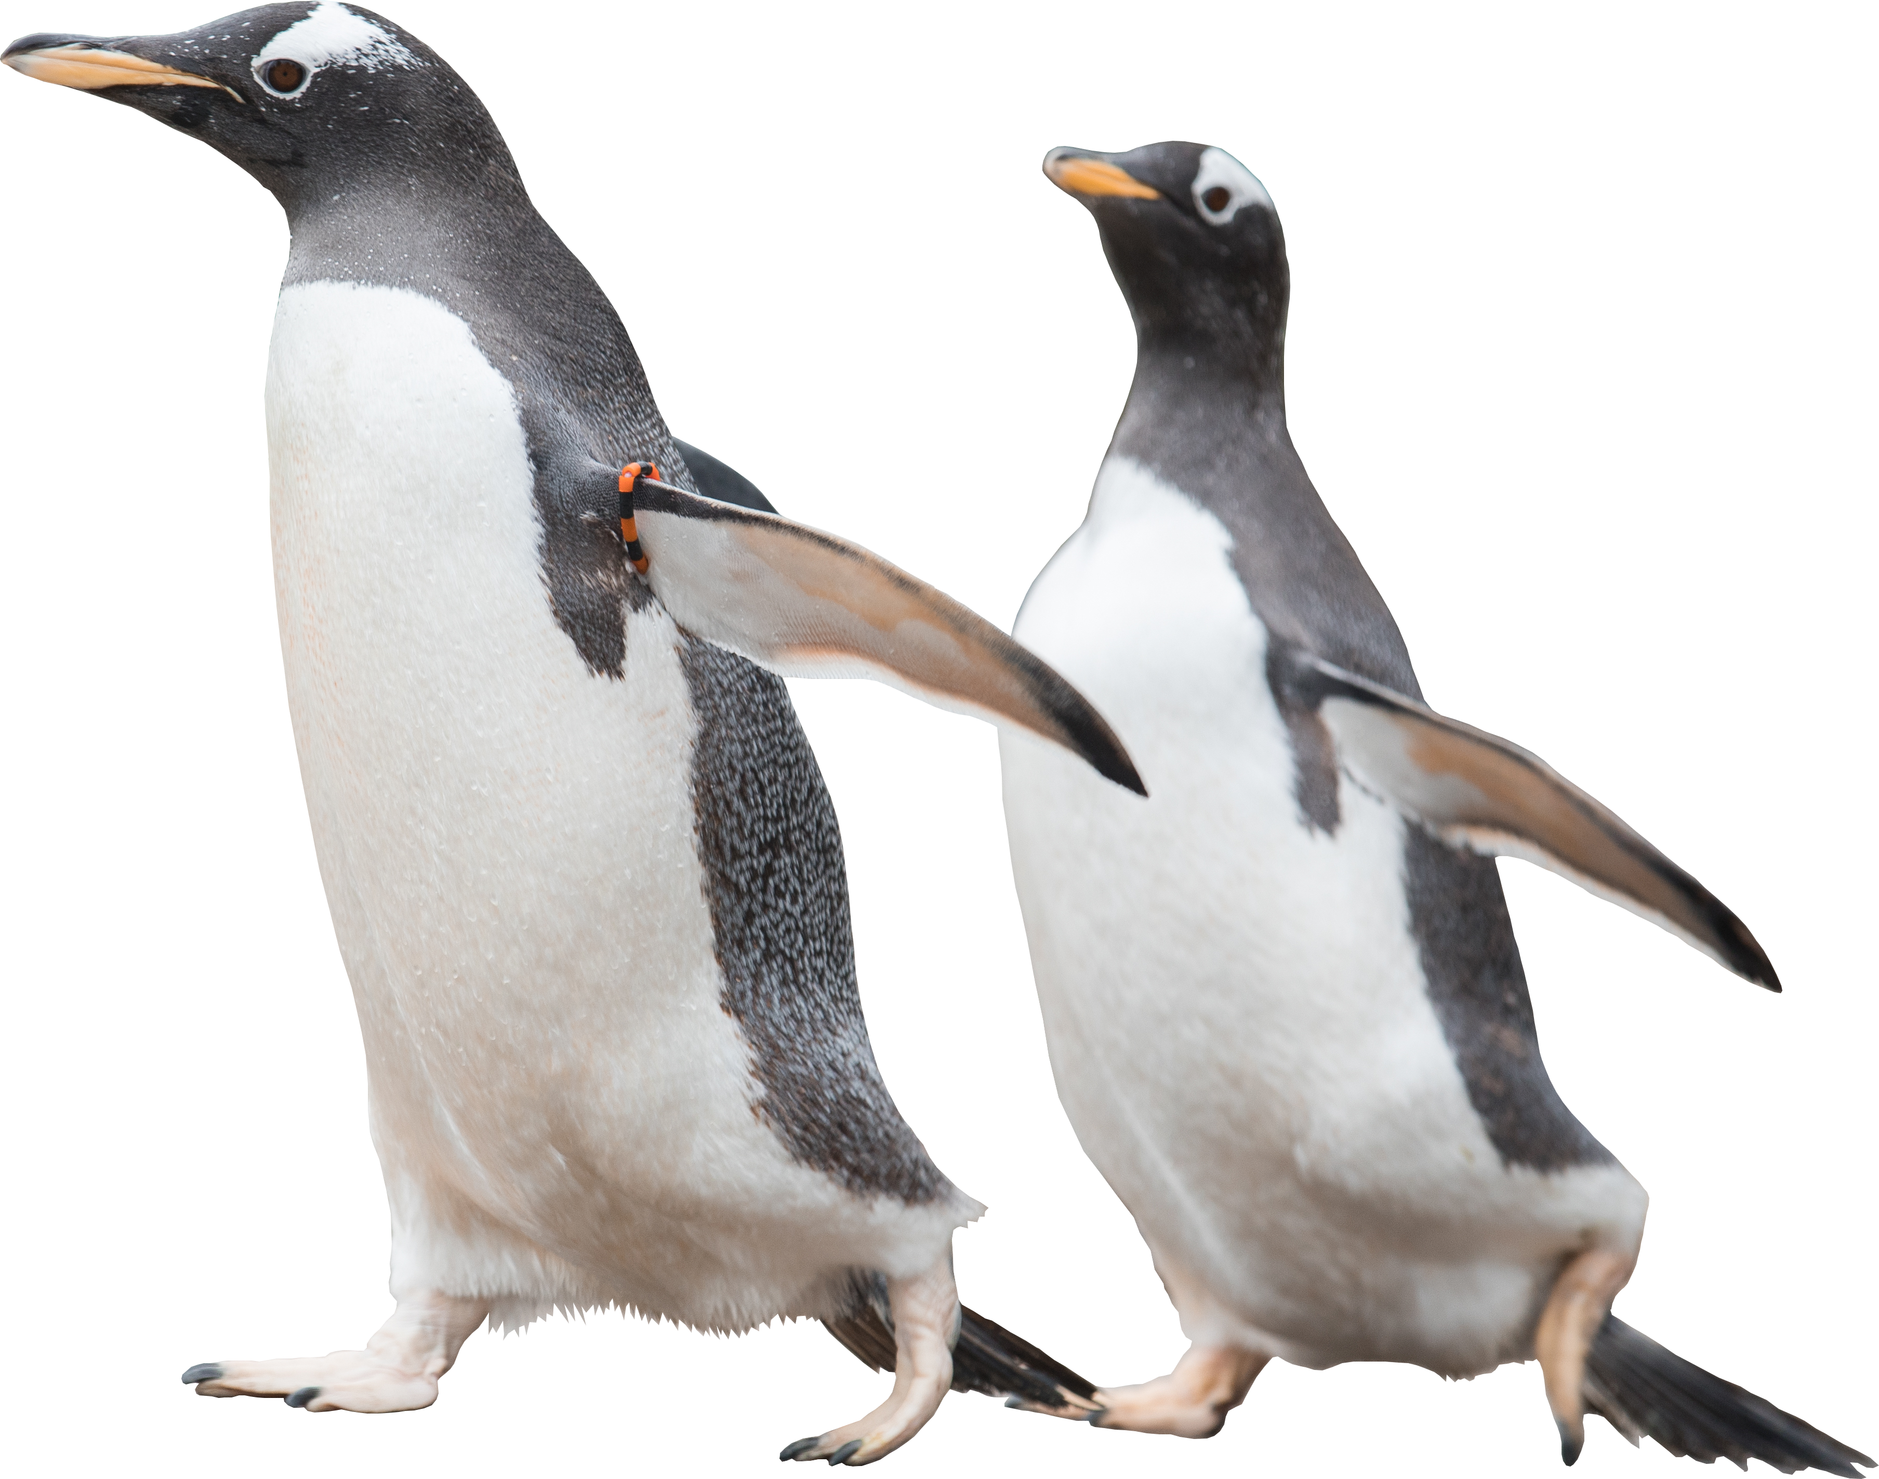
RZSS Animal Bingo
Images and information for calling bingo
In collaboration with:
Notes:
Main title slide
To be used at the beginning of the presentation, and can be used as a header to break up sections if needed.
Feel free to swap the penguins for another animal or remove entirely! (animals can be found on slide X)

Slide 2
Notes for Educators – RZSS Animal Bingo activity
The following activity has been designed as a learning opportunity with the purpose of widening pupils’ knowledge and vocabulary around biodiversity and animals.
Invite pupils to look for facts for each of the animals, plants and habitats covered in the game, adding these facts to the slides below. This can be done individually or in groups, but all facts must feed into the same file. Once completed, you can play de game with the cards provided, using the slides to call each time. We encourage you to call the facts before sharing the name and image each time, to reinforce the learning
Examples of facts that you could encourage your pupils to look for can include: where in the world they live, their habitat, their conservation status, colour of fur/skin, size, diet, where it is on the food chain, and any interesting facts or stories, past or present, related to the animal. Pupils can use the RZSS website to find some of these facts.
CfE Experiences and Outcomes supported
I can identify and classify examples of living things, past and present, to help me appreciate their diversity. I can relate physical and behavioural characteristics to their survival or extinction. SCN 2-01a
I can explore examples of food chains and show an appreciation of how animals and plants depend on each other for food. SCN 1-02a
SDGs that could be supported by the activity
SDG 13 Climate Action (by discussing for example how these animals are being affected by climate change and what is the role that zoos around the world are playing to promote conservation.)
SDG 15 Life on Land
In collaboration with:

Slide 3
RZSS Animals Bingo
Discover!
Here you will find all the animals included in the RZSS Animal Bingo game, but they are all missing something!
In order to play the game and call for each animal, your class will first needs to look for information about each of the animals and add it to each slide. Once you have lots of interesting facts, the bingo caller will be able to read the facts first before showing the photo and name of the animal, to see if players can guess which animal it is, and if they have it in their card.
Get amazed!
Learn!
Animals are so interesting!
In collaboration with:
Notes:
Bubbles
Extra information or keywords can be added in bubbles.
The text in these bubbles should be in the New Beginnings font if you have it, otherwise Calibri.
You can copy and paste these bubbles, or just draw your own circles and add text!

Slide 4
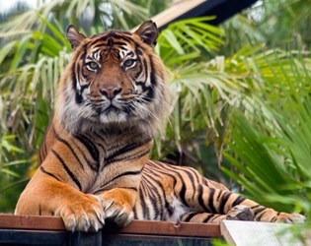
Tiger
Facts
In collaboration with:

Slide 5
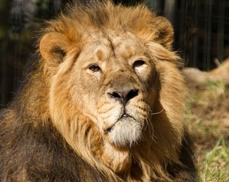
Lion
Facts
In collaboration with:

Slide 6
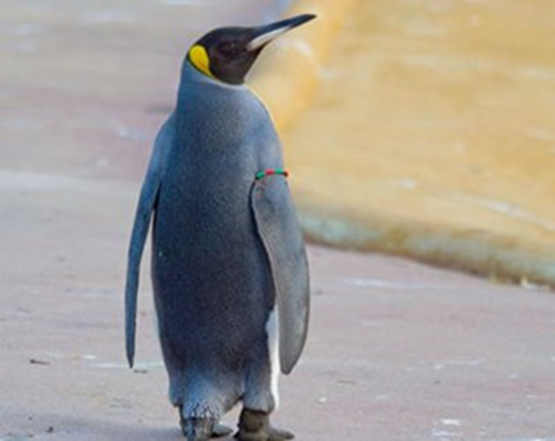
Penguin
Facts
In collaboration with:

Slide 7
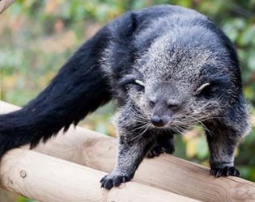
Binturong
Facts
In collaboration with:

Slide 8
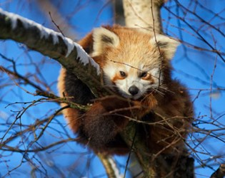
Red panda
Facts
In collaboration with:

Slide 9
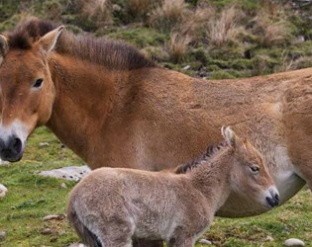
Wild horse
Facts
In collaboration with:

Slide 10
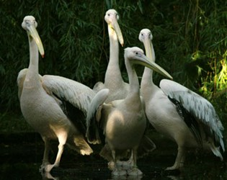
White pelicans
Facts
In collaboration with:

Slide 11
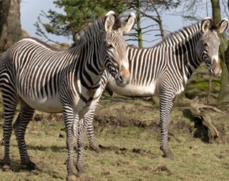
Grevy’s zebra
Facts
In collaboration with:

Slide 12
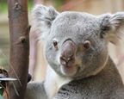
Koala
Facts
In collaboration with:

Slide 13
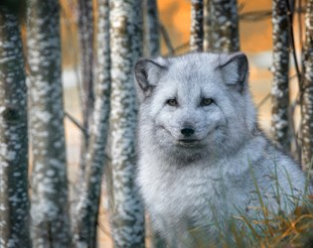
Artic fox Facts
In collaboration with:

Slide 14
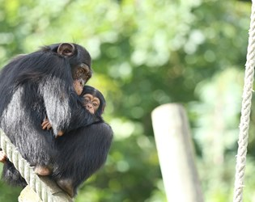
Chimpanzee Facts
In collaboration with:

Slide 15
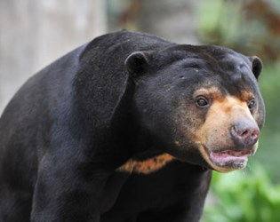
Sun bear Facts
In collaboration with:

Slide 16
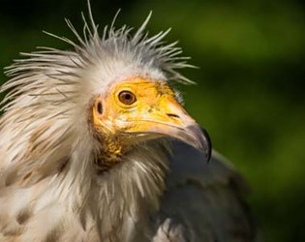
Egyptian vulture Facts
In collaboration with:

Slide 17
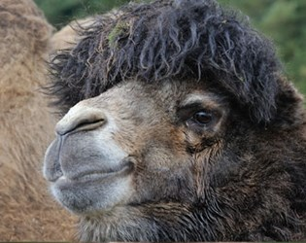
Bactrian camel Facts
In collaboration with:

Slide 18
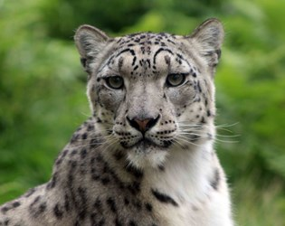
Snow leopard Facts
In collaboration with:

Slide 19
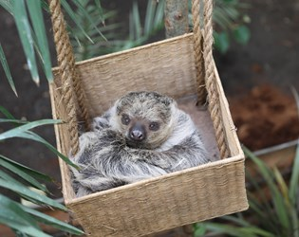
2-toed sloth Facts
In collaboration with:

Slide 20
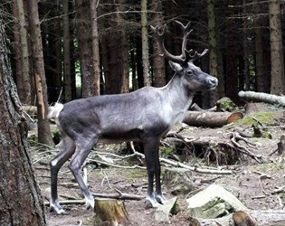
Reindeer Facts
In collaboration with:

Slide 21
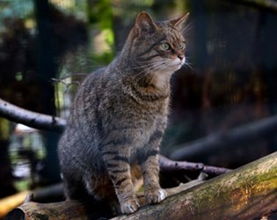
Wildcat Facts
In collaboration with:

Slide 22
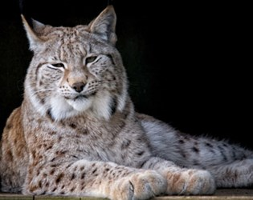
Lynx
Facts
In collaboration with:

Slide 23
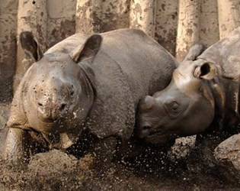
Greater one-horn rhino Facts
In collaboration with:

Slide 24
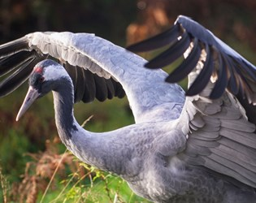
Crane
Facts
In collaboration with:

Slide 25
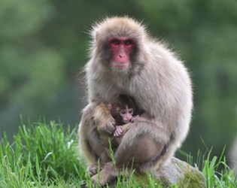
Japanese macaque Facts
In collaboration with:

Slide 26
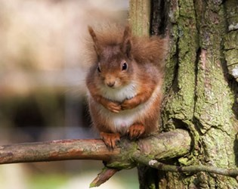
Red squirrel Facts
In collaboration with:

Slide 27
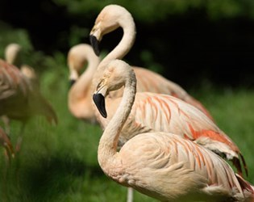
Chilian flamingo Facts
In collaboration with:

Slide 28
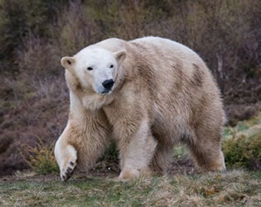
Polar bear Facts
In collaboration with:

Slide 29
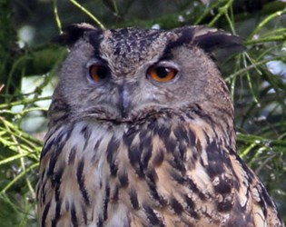
Eagle owl Facts
In collaboration with:

Slide 30
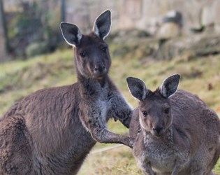
Grey kangaroo Facts
In collaboration with:

Slide 31
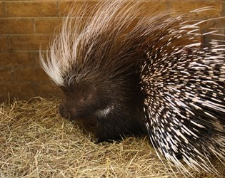
Cape porcupine Facts
In collaboration with:

Slide 32
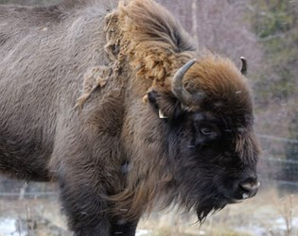
Bison
Facts
In collaboration with:

Slide 33
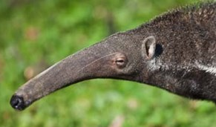
Giant anteater
Facts
In collaboration with:

Slide 34
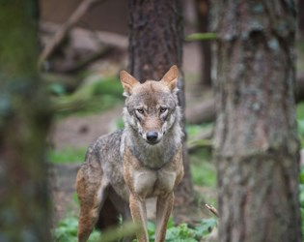
Wolf
Facts
In collaboration with:

Slide 35
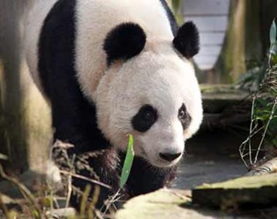
Giant panda
Facts
In collaboration with:

Slide 36
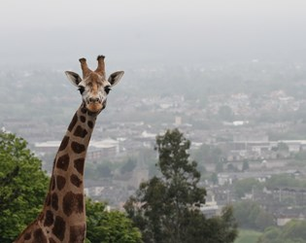
Nubian giraffes
Facts
In collaboration with:

Slide 37
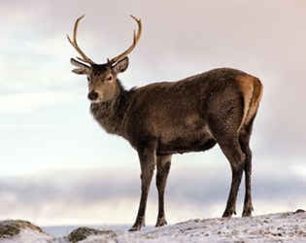
Red deer
Facts
In collaboration with:

Slide 38
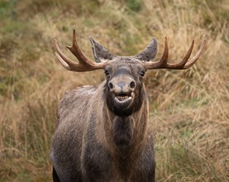
Elk
Facts
In collaboration with:

