Slide 1
INSTRUCTIONS FOR TEACHERS:
Thank you for downloading the BUZZ ABOUT BEES schools pack from the Royal Zoological Society of Scotland (RZSS).
Key words are highlighted in bold/capitals throughout; a glossary can be found at the end of this document.
The speaker notes below each slide contain useful background information and ideas for class discussion.
Why not save this document as a PDF or share the activity pages with students to try at home?
We hope you enjoy the pack and thank you for your interest in RZSS native biodiversity conservation programmes!

Slide 2
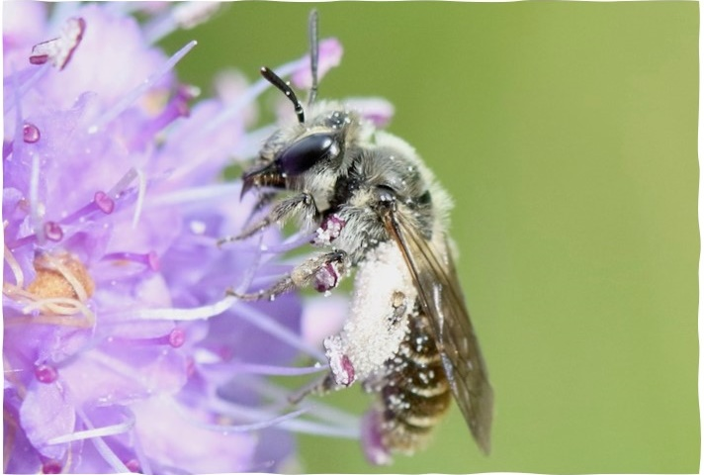
Buzz About bees!
RSPB

Slide 3
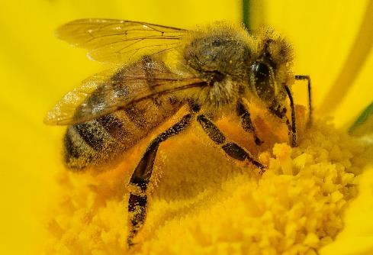
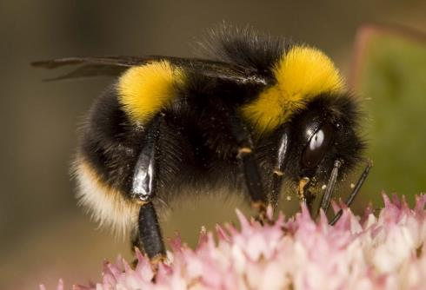
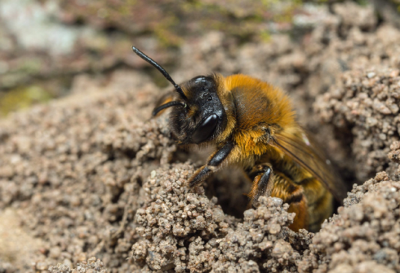
WHAT’S THAT BEE?
Here in the UK we have…
HONEYBEE
BUMBLEBEES
Solitary BEEs
Pixabay
Bumblebee Conservation Trust
People’s Trust for Endangered Species
Only 1 species
24 species
Over 250 species!
Live alone & build nests
Brilliant pollinators
Some live in bee hotels
Endangered
Lives in a hive with a Queen
Live in a small nest with a Queen
The only bee that makes honey
Brilliant pollinators
Endangered
Very rarely stings
A farmed animal
Not endangered
Includes mining, mason & leafcutter bees
Notes:
In the UK we have three types of bees. Honeybees that live in a hive and make honey. These bees are farmed and have people to look after them, so they are not endangered. There is only one species of honeybee in the UK. We also have bumblebees – these are big and fluffy, and live in a nest (often old rodent burrows). They don’t make honey and they are very placid. They are excellent pollinators as they are covered in hair, and this hair also keeps them warm. They are well-adapted to cold weather and evolved in the Himalayas! We have 24 species of bumblebee in the UK. The third type is solitary bees – this is the one not many people know! We have over 250 species of solitary bee in the UK, meaning they are responsible for pollinating lots of the food we eat. They live alone and many build tunnels or live in bee hotels. Solitary bees include mining bees (that build tunnels), mason bees (who make nests in cavities) and leafcutter bees (that make their nests out of discs of leaf that they cut with their mouth)!

Slide 4
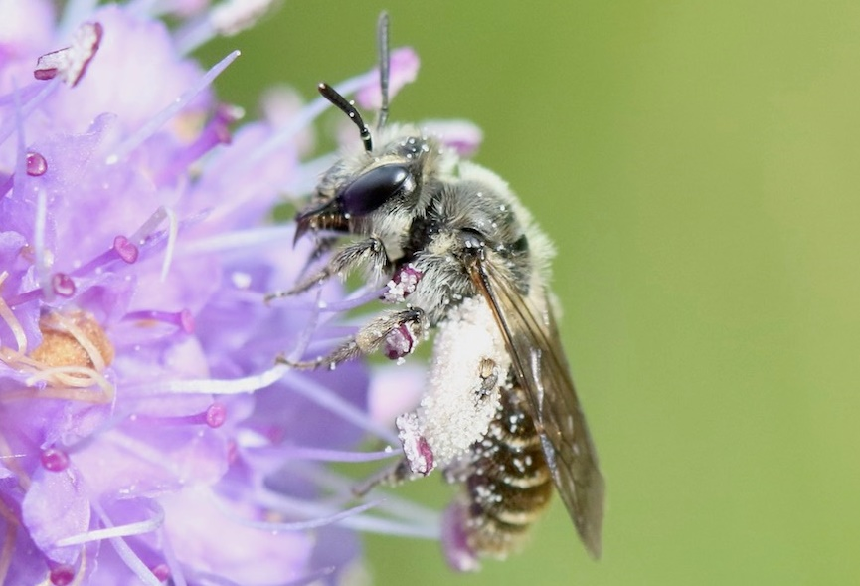
ANTENNAE
Small scabious
mining bee
STRIPeY
BODY
SCABIOUS
FLOWERS
POLLEN
TROUSERS
Notes:
At Highland Wildlife Park, we have a very special rare bee called a small scabious mining bee. It builds tunnels in sunny banks of soil and only collects pollen from scabious flowers. When it collects pollen, the pollen sticks to its legs like big white trousers! We are carrying out surveys and planting flowers to protect it and help its population grow.

Slide 5
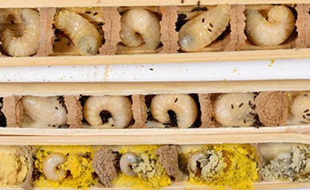
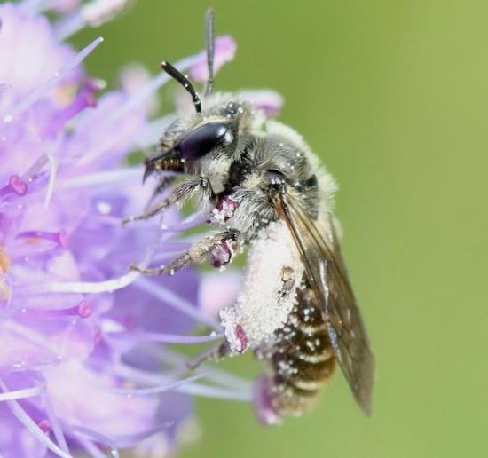
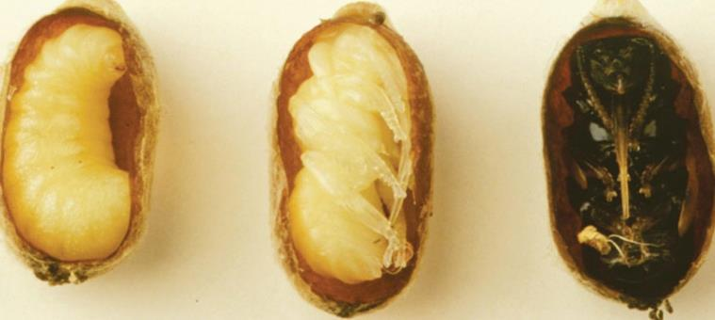
MINING BEE LIFECYCLE
IN NEST
Egg
ADULT
Larva
Pupa inside a cocoon
Crown Bees
Notes:
Jut like butterflies, bees also have a life cycle and go through metamorphosis. They start off as eggs, then hatch into larvae (like a caterpillar). They then pupate in a cocoon, and the adult bee emerges. This all takes place in their burrow or nest. The yellow powder in the egg chamber is flower pollen – food for the larvae.

Slide 6
MINING BEE LIFECYCLE
Egg
Nest-building
Larva
Mating
Pupa
Adult
Flaticon
Notes:
In Spring – Summer, the female bee builds a nest and lays her egg. She leaves them a stash of pollen to eat, then seals the egg chamber and flies away. The young bees spend the whole Winter sleeping inside their nest. When the weather warms up next Spring, they go into their pupa and transform into an adult. The adult bees emerge, mate and the cycle begins again.

Slide 7
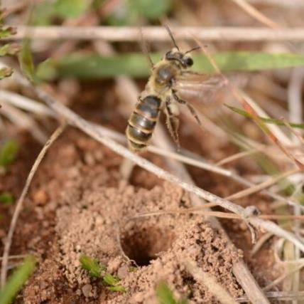
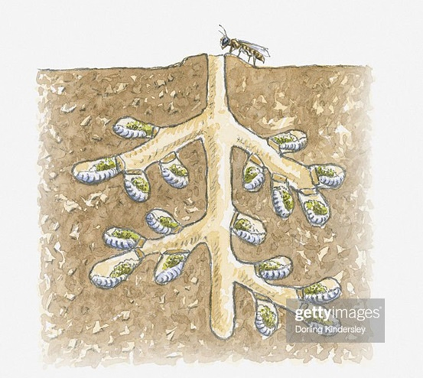
A home for mining bees
Stewart Taylor
Mining bees build TUNNELS in the GROUND, leaving a mound of soil that looks like a tiny VOLCANO!
Brood cell
The females lay their EGGS in these tunnels along with a stash of POLLEN. The larvae sleep under the ground all WINTER and emerge as adults in the SPRING.
ON YOUR NEXT WALK, CAN YOU SPOT THE TELLTALE TUNNEL OF A MINING BEE?
Egg
Pollen

Slide 8
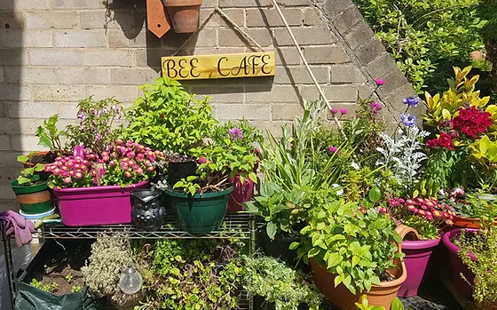
ACTION FOR BEES
REMEMBER – HONEYBEES PROVIDE YUMMY HONEY, BUT ARE NOT ENDANGERED AND NOT NATIVE POLLINATORS!
EAT ORGANIC FRUITS & VEGGIES GROWN WITHOUT CHEMICALS
NEVER USE PESTICIDES!
THESE CAN POISON BEES
PLANT A BEE CAFÉ FULL OF NECTAR-RICH NATIVE FLOWERS THAT BLOOM ALL YEAR ROUND!
TAKE PART IN NO-MOW-MAY AND LET YOUR LAWN GROW
LONG for WILDFLOWERS!
Buzz Club
PROVIDE LONG GRASS & COMPOST PILES FOR HIBERNATING QUEENS

Slide 9
GLOSSARY FOR TEACHERS
Key words are highlighted in bold/capitals throughout, please find definitions below:
POLLINATOR – an insect that carries pollen between plants so the plant can reproduce.
ANTENNAE – ‘feelers’ on an insect’s head that let it detect the world around it.
LARVA – a young insect that looks worm-like & has no wings e.g. caterpillar, grub.
PUPA – stage when an insect is immobile and enclosed in a case, before transforming into an adult.
METAMORPHOSIS – transformation process of life stages that most insects go through.
NATIVE – where an animal or plant naturally occurs without human interference.
THORAX – the middle section of an insect’s body, between the head and abdomen.
ABDOMEN – the largest, bottom section of an insect’s body where its organs are stored.

Slide 10
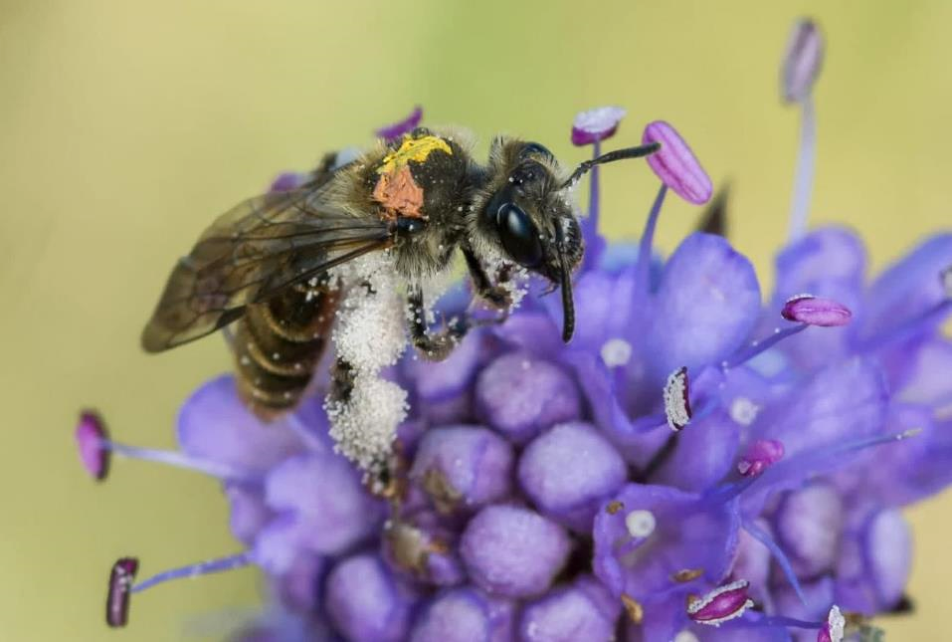
BUILD-A-BEE!
Can you match each KIND OF BEE with its UNIQUE FEATURES?
Notes:
Build-a-Bee is a printable activity. Print the pages, and on each ‘cut-out page’ use scissors to carefully cut the bee into three sections along the dotted lines. Follow the 3 clues on each bee page to put the 3 body segments in the correct place and build your own honeybee, bumblebee and solitary bee!

Slide 11
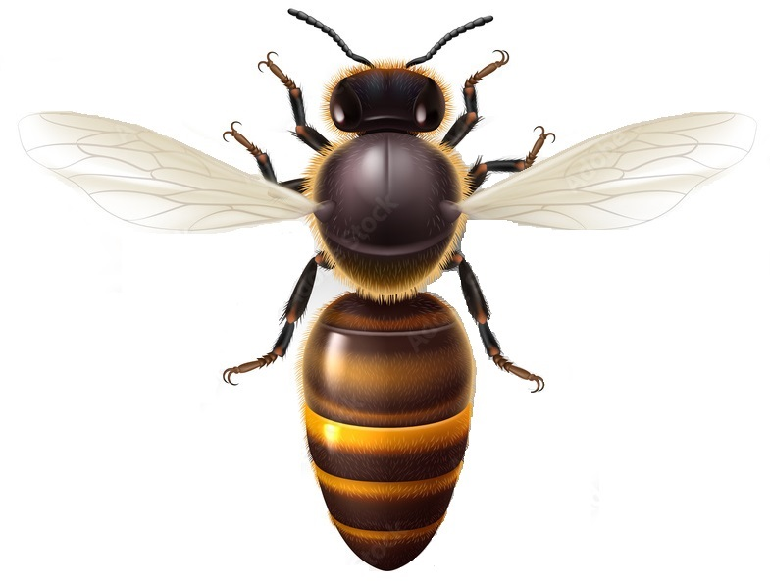
HONEYBEE
My head is OVAL with GOLD HAIRS
1
1
My body (thorax) is ROUND and brown with GOLD HAIRS
2
2
My stripes are GOLD & brown, my lower body (abdomen) is V-SHAPED
3
3

Slide 12
HONEYBEE
CUT-OUT
PAGE
1
2
3

Slide 13
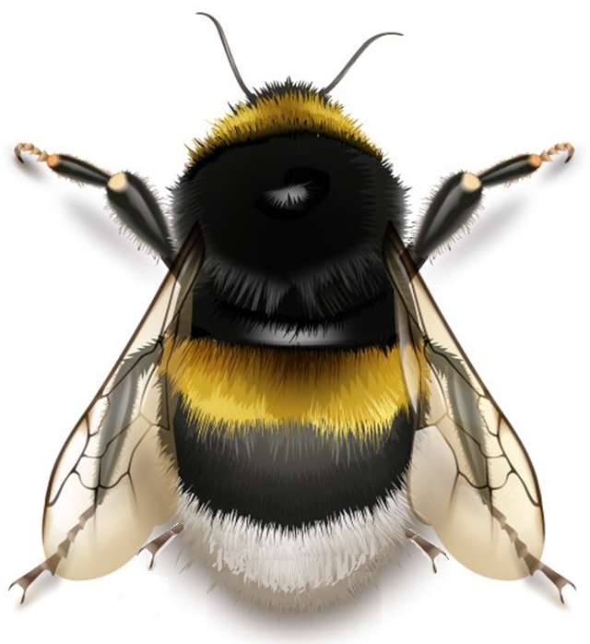
BUMBLEBEE
My head is SMALL and FLUFFY
1
1
2
My body (THORAX) is BIG, ROUND & fluffy
2
I have YELLOW, BLACK & WHITE stripes.
3
3

Slide 14
bumblebee
CUT-OUT
PAGE
1
2
3

Slide 15
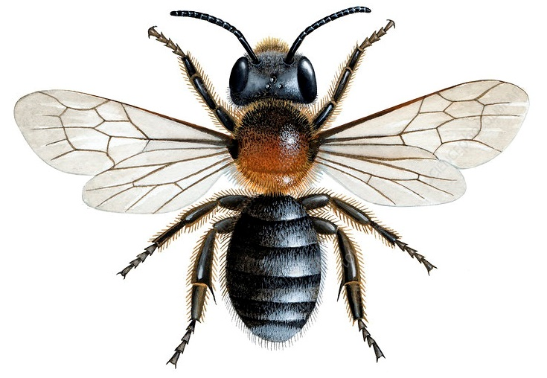
MINING BEE
My head is GREY & only slightly FUZZY
1
1
2
My body (THORAX) is sMALL, ROUND & COPPER colour
2
3
3
I have NO STRIPES

Slide 16
CUT-OUT
PAGE
MINING BEE
1
2
3

