Slide 1
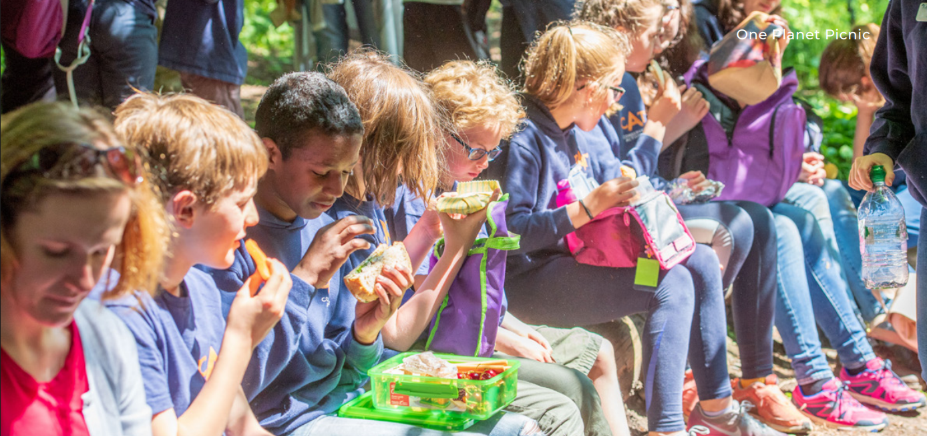
One Planet Picnic
Your charity for Scotland’s environment
Notes:
Introduce the session.
Explain that today learners will explore sustainable food choices and Scottish Gaelic food culture.
Explain that they will work towards planning their own One Planet Picnic.

Slide 2
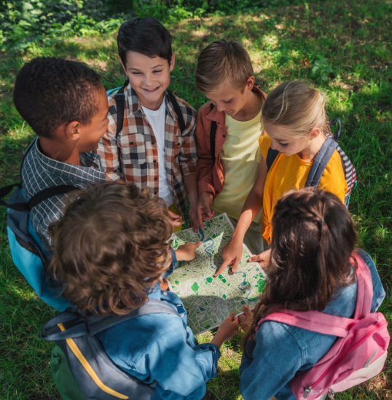
By the end of the session, you will:
Have better awareness of One Planet Living and sustainable food choices.
Explore Gaelic food culture and traditional Scottish ingredients.
Start to think about how best to run a One-Planet Picnic

Slide 3

1. What are your favourite foods?
2. What are sustainable foods?
Notes:
Explain that some foods are better for the environment because of how they are grown, transported and packaged.

Slide 4
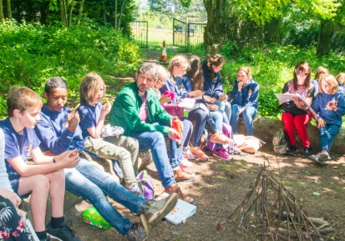
What is a One Planet Picnic?
The difference between a One Planet Picnic and other picnics is that:
A One Planet Picnic is “good for you
and good for the planet!”
and
Notes:
Your One Planet Picnic can be for your snack, lunch or tea.

Slide 5

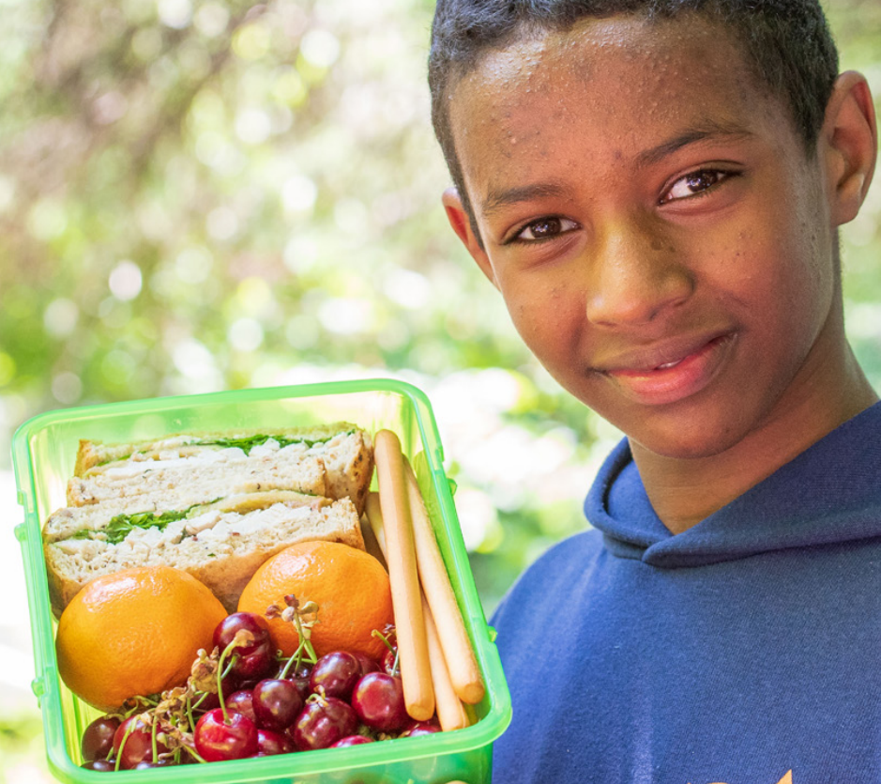
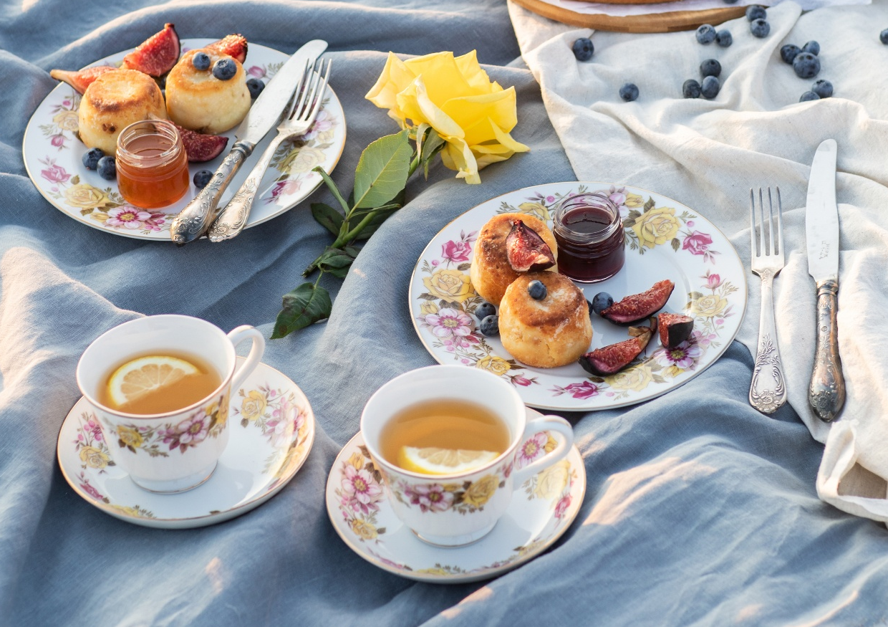


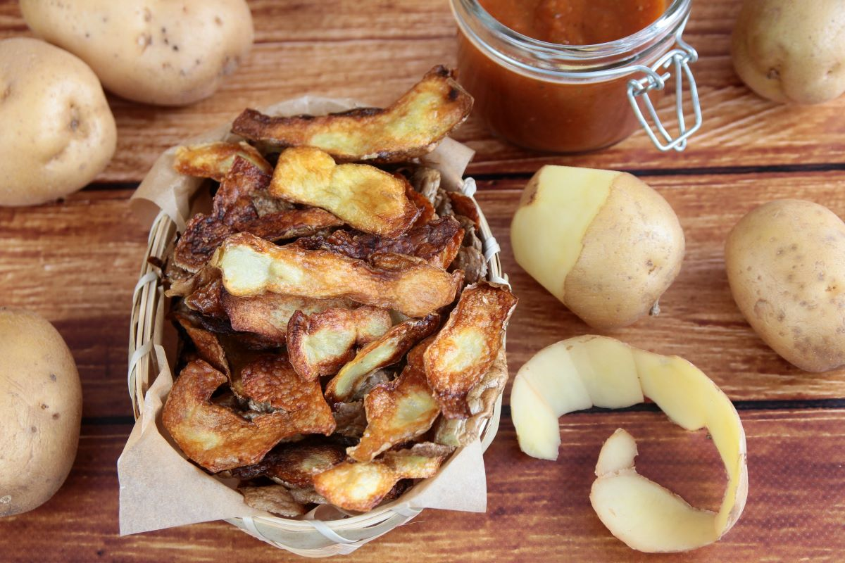

Question: How do I make it a One Planet Picnic?
1. Reduce waste:
Compostable
Home grown and made food
Portion control
Less food packaging...
...avoid single-use items.
Recyclable
Notes:
Reducing waste
Encourage pupils to think about how they can create less rubbish and make use of leftovers instead of throwing food away.
Reusing containers and cutlery
Using lunchboxes, water bottles and reusable cutlery helps reduce the amount of waste created during a picnic.
Avoiding single-use items
Single-use plastics and disposable items are often used once and then thrown away. Reusable alternatives are a more sustainable choice.
Choosing local food
Food grown or produced locally usually travels a shorter distance, helping to reduce transport emissions and support local businesses.
Reducing packaging
Choosing foods with little or no packaging helps reduce waste and makes a picnic more environmentally friendly.
Portion control
Taking only what is needed can help prevent food waste and ensure food is not thrown away unnecessarily.

Slide 6
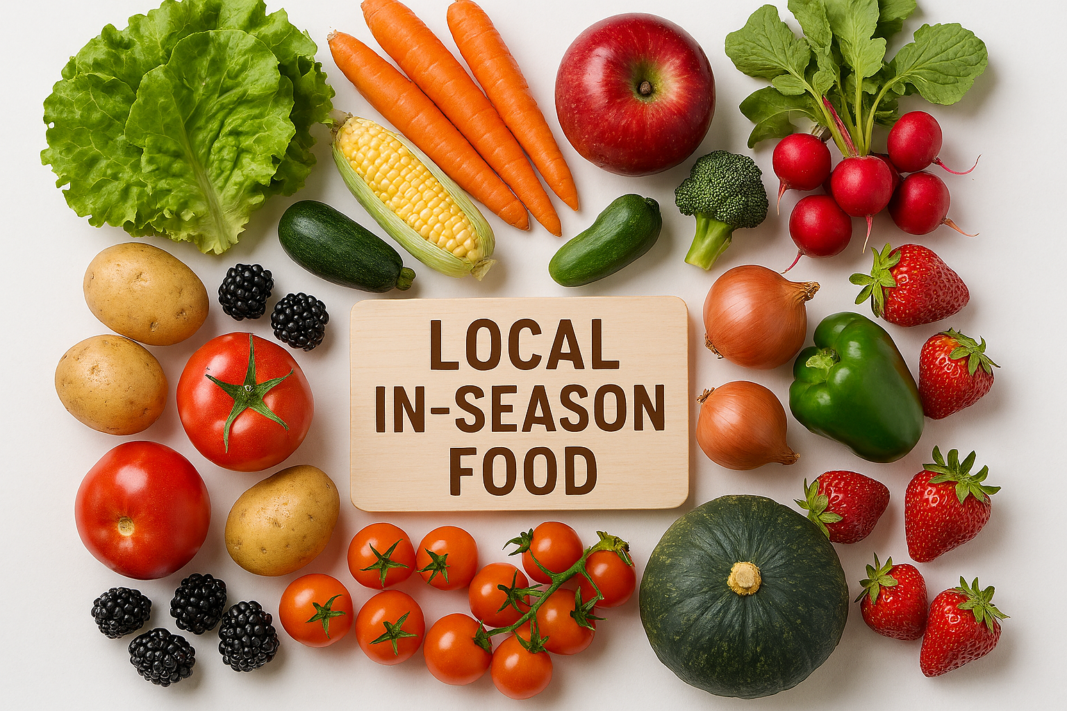
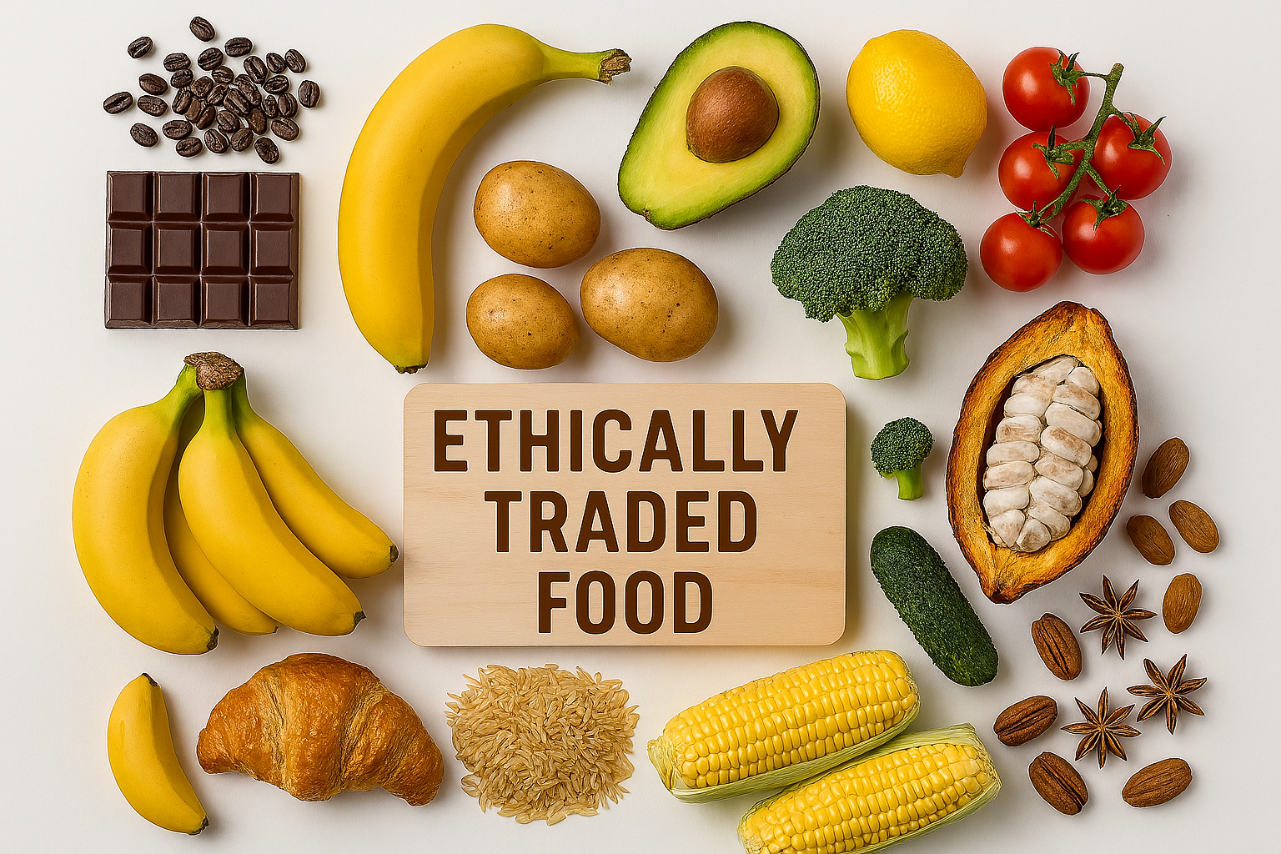

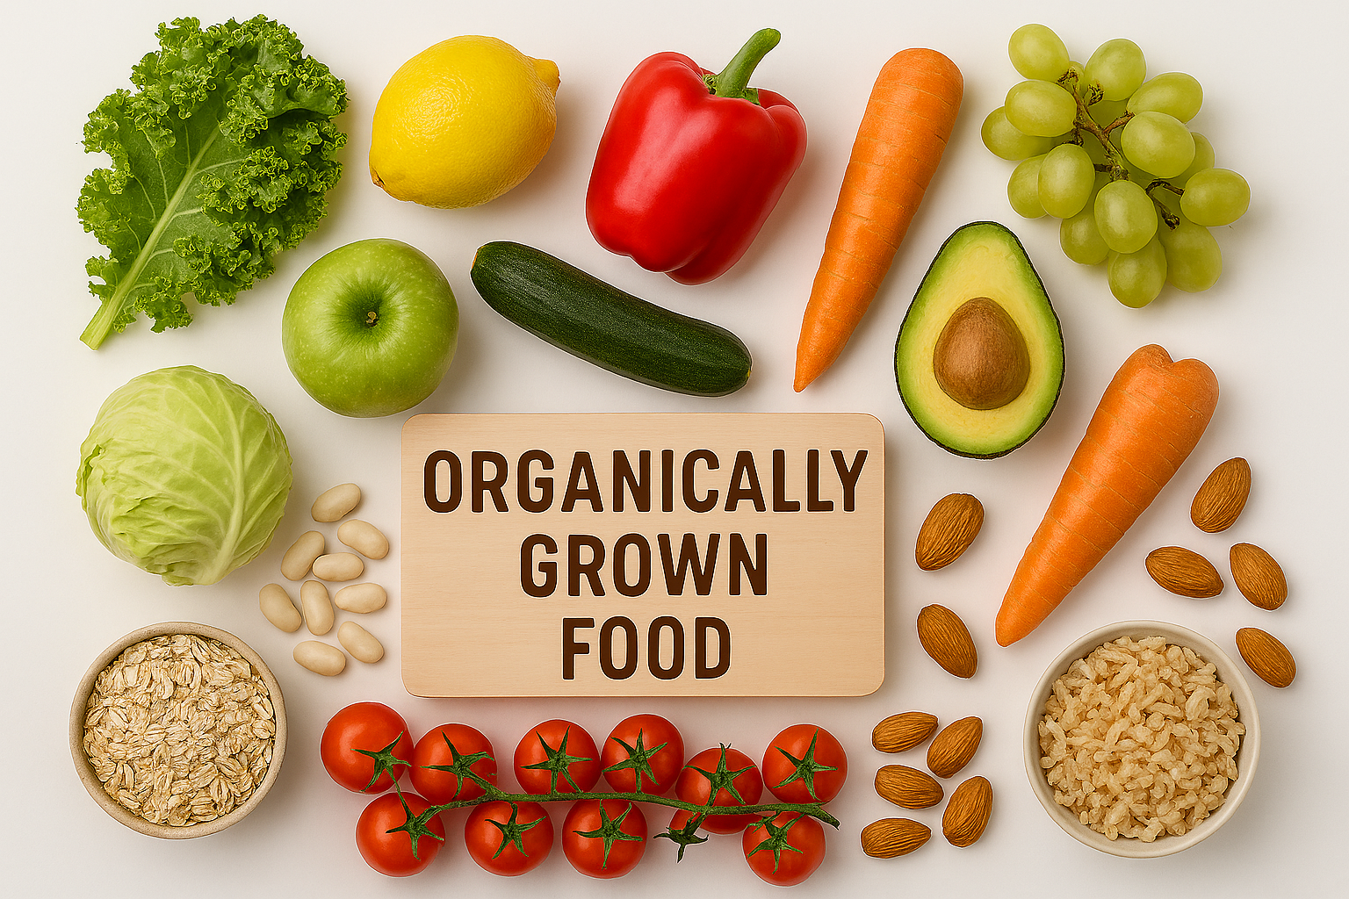





Question: How do I make it a One Planet Picnic?
2. Include foods that are more environmentally friendly:
Notes:
1. Local, In-Season Food
Different food crops are ready to eat at different times of the year. Foods are in season when they are ready to harvest and eat. Eating food in season means it has been grown using the local weather conditions and has not been stored for a long time.
In season local food is food grown or made closer to where you live. Buying it supports local producers and reduces energy used to produce it.
2. Ethically Traded Food
We eat food that is grown in countries around the world and imported to Scotland, bananas for example, which are Scotland’s most popular fruit. Why do we import them? There are different laws in different countries and at sea. Some are better at respecting their workers and wildlife than others.
Ethical trade means that the lives and rights of the workers, wildlife and the environment involved in producing the item were respected.
3. Organically Grown Food
There are different ways that food can be grown. An organic farming system looks after wildlife as well as producing food.
Organically grown food avoids man-made fertilisers, pesticides and, growth regulators and feed additives for its animals.

Slide 7
Question: How do I make it a One Planet Picnic?
Include:
Exclude:
Reusable cutlery, plates etc.
Local in-season food
Ethically traded food
Organically grown food
The right portions
Single-use items
Food with a high carbon footprint
Food Waste
General Environmental Impacts
Notes:
ASK: What do we include, What do we exclude,

Slide 8
Activity: One Planet Menu Collab
In groups you must create a super-quick picnic menu and say how it is served!
Remember: Local in-season food, ethically traded food, organically grown food and packaging!
Notes:
Resource: One Planet Picnic Planning Sheet (Menu Tick Box Activity) available on our website

Slide 9
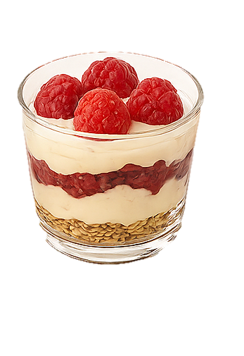





Question: How could I represent Scottish Gaelic within a One Planet Picnic?
1. Traditional Foods:
Dearcan
Berries
Crannachan
Cranachan
Arain-coirce
Bonnach
Mil an fhraoich
Oatcakes
Bannock
Gruth
Heather-honey
Crowdie
Notes:
Resource: Gaelic Recipes available on our website
Oatcakes (Arain-coirce)
Oats were the main crop in many Gaelic-speaking regions due to the harsh climate. Oatcakes were an everyday food carried by crofters, fishermen, and drovers — essentially a cornerstone of Gaelic diet and rural life. They feature regularly in Gaelic songs and stories as a symbol of hospitality and survival.
Bannock (Bonnach)
Bannocks are traditional flat breads made from oats or barley, deeply rooted in Highland and island life. They were a staple food for Gaelic-speaking communities for centuries, used at festivals like Bliadhn’ Ùr, Là Fhèill Brìghde (Date: 1st February
What it is: A Gaelic festival celebrating Brigid of Kildare, who is associated with fertility, healing, poetry, and domestic crafts.), and Lughnasadh (Date: 1st August What it is: A Gaelic harvest festival honouring Lugh, a Celtic god of craftsmanship, light, and skills.). Many bannock traditions appear directly in Gaelic folklore and seasonal customs.
Crowdie (Gruth)
Crowdie is a soft Scottish cheese long associated with crofting communities in the Highlands. It was commonly made in Gaelic-speaking households because it required simple ingredients and no advanced equipment. The name itself is often linked with traditional Gaelic dairy practices.
Heather-honey (Mil an Fhraoich)
Heather-honey is produced from the purple heather that carpets much of the Highlands — one of the most iconic plants in Gaelic landscape imagery. Heather (fraoch) appears constantly in Gaelic place names, songs, metaphors and clan symbolism. Honey from heather was a prized natural sweetener in Gaelic communities.
Berries (Dearcan)
Wild berries (fraochan/blaeberries, raspberries, brambles) grow abundantly in the Highlands and appear frequently in Gaelic nature poetry and seasonal food traditions. Berry picking was a communal activity in many Gaelic-speaking areas and still ties strongly to the landscape of the Gàidhealtachd.
Cranachan
Cranachan is a traditional Scottish dessert made with oats, cream, whisky, and berries — all ingredients strongly connected to Gaelic agriculture and seasonal celebrations. It comes from Highland food culture and is often linked to harvest traditions and summer gatherings in Gaelic areas.

Slide 10
Question: How could I represent Scottish Gaelic within a One Planet Picnic?
2. Gaelic phrases:
P
E
R
S :
O
N
1
Dearcan [JER-kun] – berries
P
E
R
S :
O
N
2
Faodaidh [FOH-ee] – Yes you can
Arain-coirce [AR-an KOR-kyuh] – Oatcakes
Am faod mi
[um fawd mee]
– can I have?
or
Gruth [GROO] – Crowdie
Mil an fhraoich [MEEL un RAYKH] – Heather-honey
Chan
Fhaod [chan EH-oot] –
No you can’t
SWITCH

Slide 11
Activity: Plan your Gaelic One Planet Picnic (cèilidh)!
Decide location
Decide how to get there
Choose from the list of sustainable food choices that reflect traditional Scottish cuisine
Decide how it is served
Choose from a list of traditional Scottish music
Choose a Gaelic phrase to include
Choose who will accompany you
Notes:
This activity allows learners to use what they have learned to design a realistic One Planet Picnic. Encourage them to think about how their choices around food, travel, packaging and culture can help reduce environmental impact while celebrating Scottish Gaelic heritage.
Resource: One Planet Picnic Planning Sheet (Menu Tick Box Activity) available on our website

Slide 12



^{Tapadh}
^{Leibh}
Cuir fios thugam:
T: 01786 471333
E: Jonathan.Angell@KeepScotlandBeautiful.org
@KSBScotland
@KSBScotland
@Keep Scotland Beautiful

