Slide 1

One Planet Picnic
What, how, who, when and why to have one.
Your charity for Scotland’s environment

Slide 2
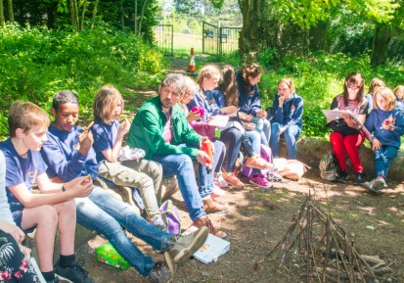
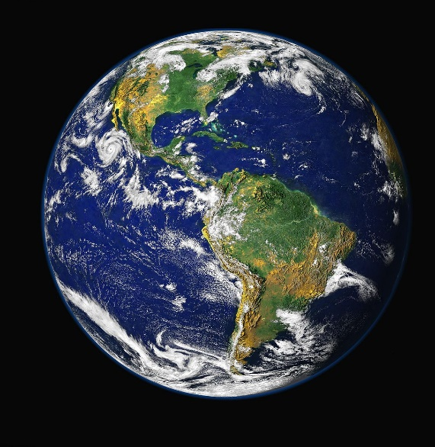
What is a One Planet Picnic?
The difference between a One Planet Picnic and other picnics is that:
A One Planet Picnic is “good for you and good for the planet!”
and
Your One Planet Picnic can be for your snack, lunch or tea.
This Photo by Unknown Author is licensed under CC BY-SA
Keep Scotland Beautiful is a Scottish Charitable Incorporated Organisation (SCIO): Number SC030332. Copyright © Keep Scotland Beautiful 2020. All rights reserved.

Slide 3
Question How do I make it a One Planet Picnic?
Answer
Include foods that are more environmentally friendly, and
Reduce waste.
As far as possible try to:
Include
Local, in-season food
Organically grown food
Ethically traded food
Reduce
Food waste
Packaging waste
Keep Scotland Beautiful is a Scottish Charitable Incorporated Organisation (SCIO): Number SC030332. Copyright © Keep Scotland Beautiful 2020. All rights reserved.

Slide 4















Who can have a One Planet Picnic?
Your class, friends, or colleagues
Your family
You
You can have a One Planet Picnic by yourself, or with others.
Use #OnePlanetPicnic to share the fun.
Keep Scotland Beautiful is a Scottish Charitable Incorporated Organisation (SCIO): Number SC030332. Copyright © Keep Scotland Beautiful 2020. All rights reserved.

Slide 5

When can I have a One Planet Picnic?
On a day & time to suit you.
As a celebration.
As often as you like.
When will yours be?
Keep Scotland Beautiful is a Scottish Charitable Incorporated Organisation (SCIO): Number SC030332. Copyright © Keep Scotland Beautiful 2020. All rights reserved.

Slide 6
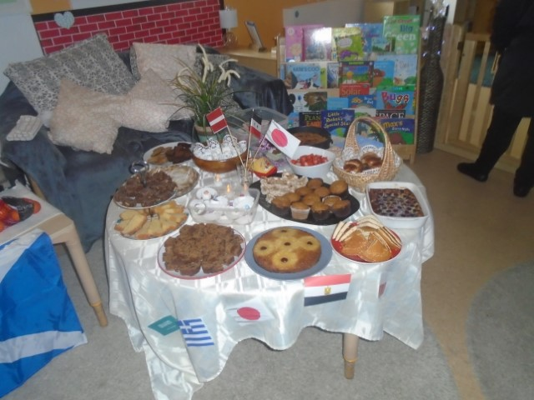
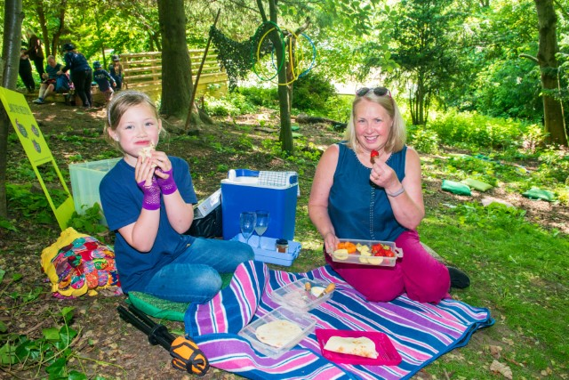
Where can I have a One Planet Picnic?
Outside is best if you are meeting other households.
You and your family can have one indoors too.

Slide 7
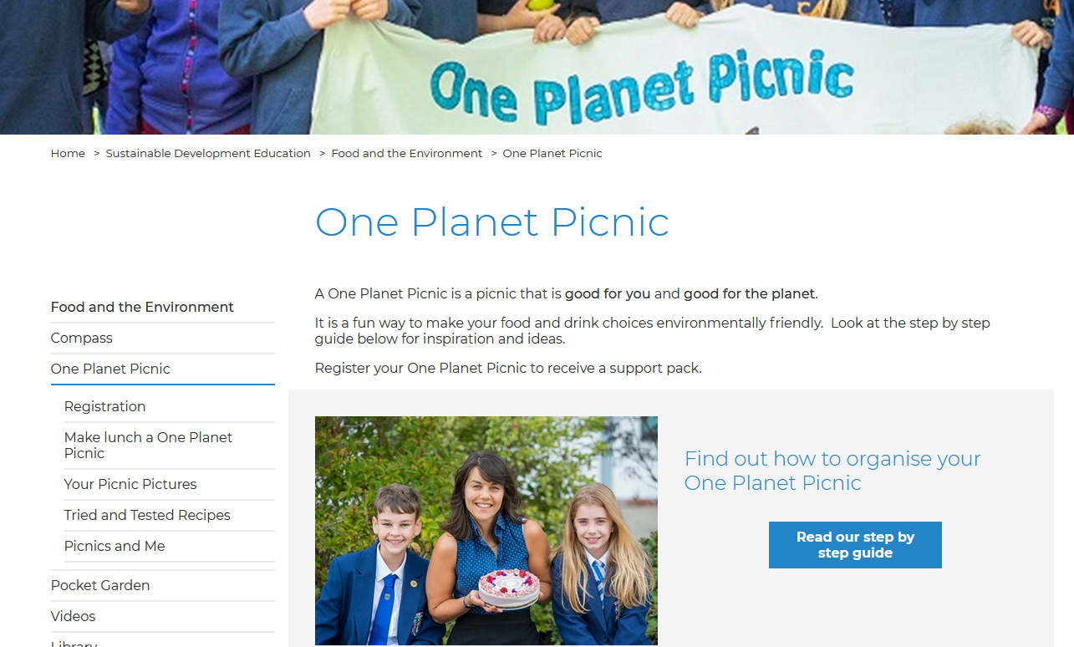
Register your One Planet Picnic
www.keepscotlandbeautiful.org/oneplanetpicnic
Keep Scotland Beautiful is a Scottish Charitable Incorporated Organisation (SCIO): Number SC030332. Copyright © Keep Scotland Beautiful 2020. All rights reserved.

Slide 8
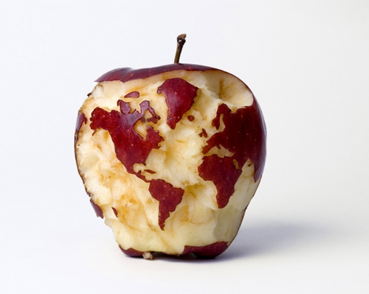
Why have a One Planet Picnic?
It’s fun.
Tasty food.
Reduce your carbon footprint.
Find out about environmentally friendly food. (The next slides explain a bit more about that.)
What are your reasons?

Slide 9



Reduce Waste
Food waste creates greenhouse gases so it adds to climate change.
You can reduce both Food waste and Packaging waste.
Here are some logos that tell you the packaging is recyclable. One is for glass and the other is on some plastic film packaging.
This one tells you the plastic is compostable. It should go in your garden waste bin.

Slide 10
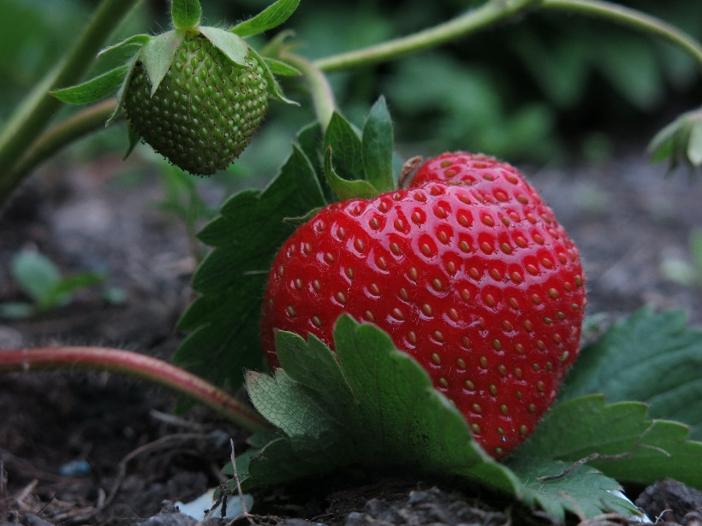
Local and Seasonal food
Different food crops are ready to eat at different times of the year. Foods are in season when they are ready to harvest and eat. Eating food in season means it has been grown using the local weather conditions and has not been stored for a long time.
In season local food is food grown or made closer to where you live. Buying it supports local producers and reduces energy used to produce it.
Which of these two strawberries is ready to eat?

Slide 11
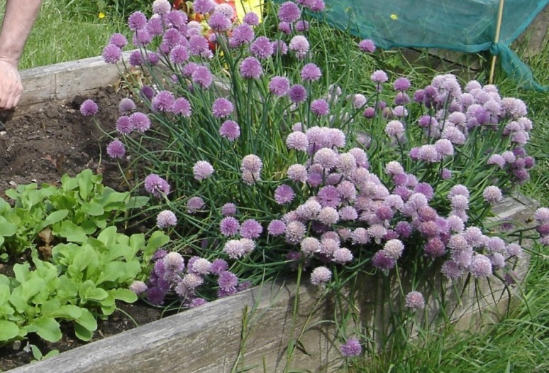
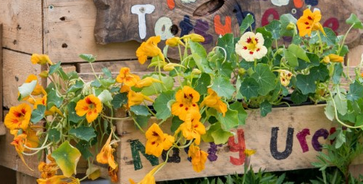
Home grown ingredients are very local
Some flowers are edible. Here are two you could grow yourself. They are in season in summer and early autumn in Scotland.
Chives
Nasturtiums

Slide 12





Organically grown
There are different ways that food can be grown. An organic farming system looks after wildlife as well as producing food.
Organically grown food avoids man-made fertilisers, pesticides and, growth regulators and feed additives for its animals.
Here are some logos that tell you the food was grown this way.

Slide 13


Ethically traded
We eat food that is grown in countries around the world and imported to Scotland, bananas for example. There are different laws in different countries and at sea. Some are better at respecting their workers and wildlife than others.
Ethical trade means that the lives and rights of the workers, wildlife and the environment involved in producing the item were respected.
Here are two logos that tell you the food was produced this way.

Slide 14
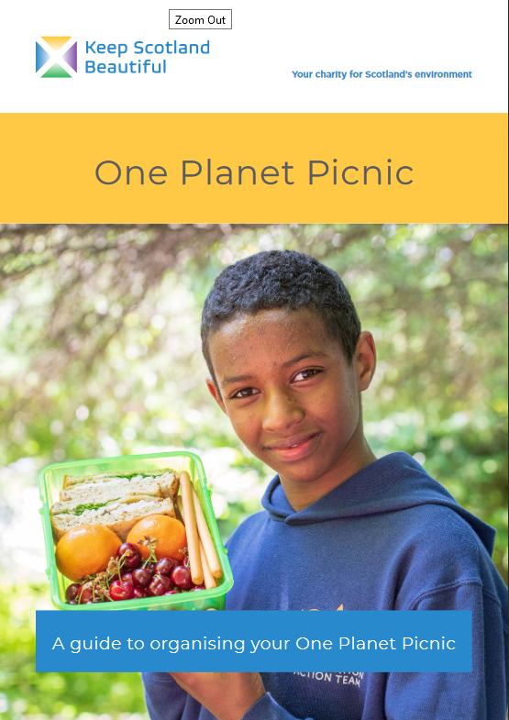
Further information
Download this step by step guide to organising your One Planet Picnic.
There are lots of tips and links to help you see what food is in season and to find where it is available locally.
www.keepscotlandbeautiful.org/oneplanetpicnic

Slide 15
Happy One Planet Picnicking

